Slide 1
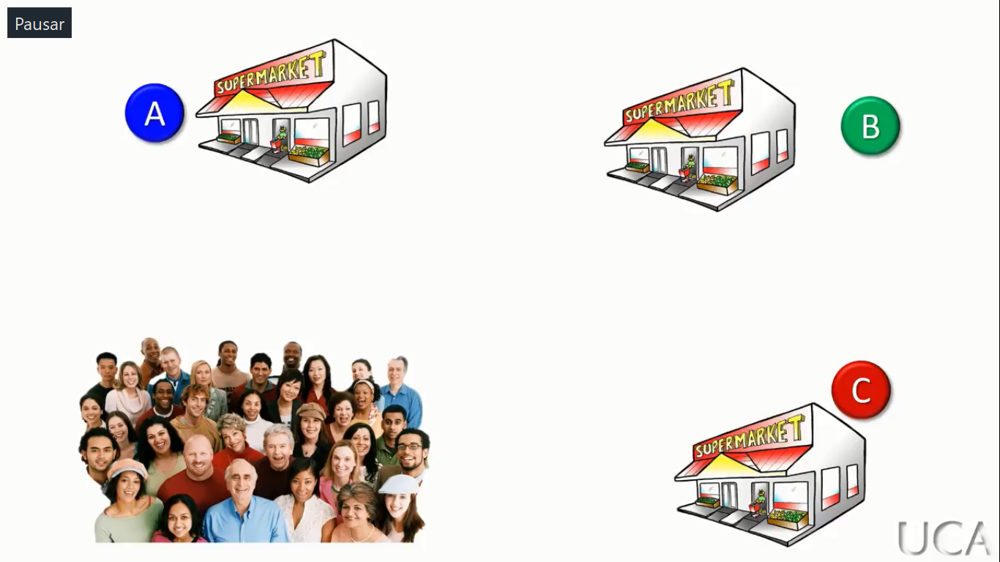
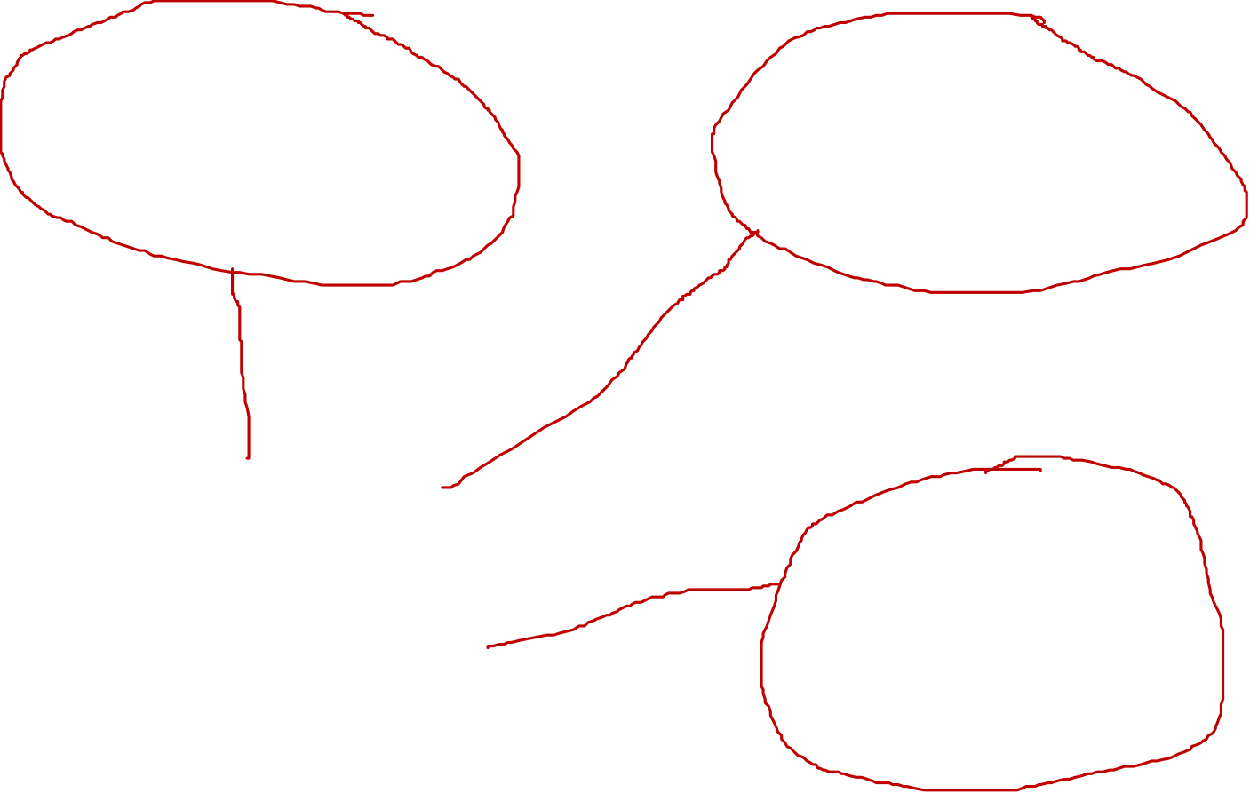

Slide 2
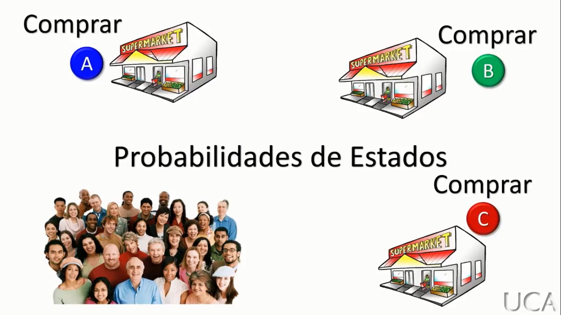
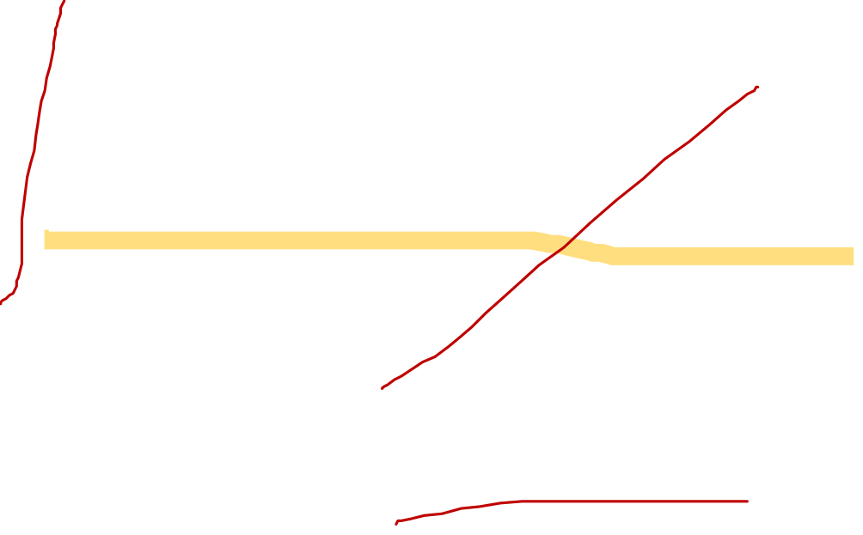

Slide 3
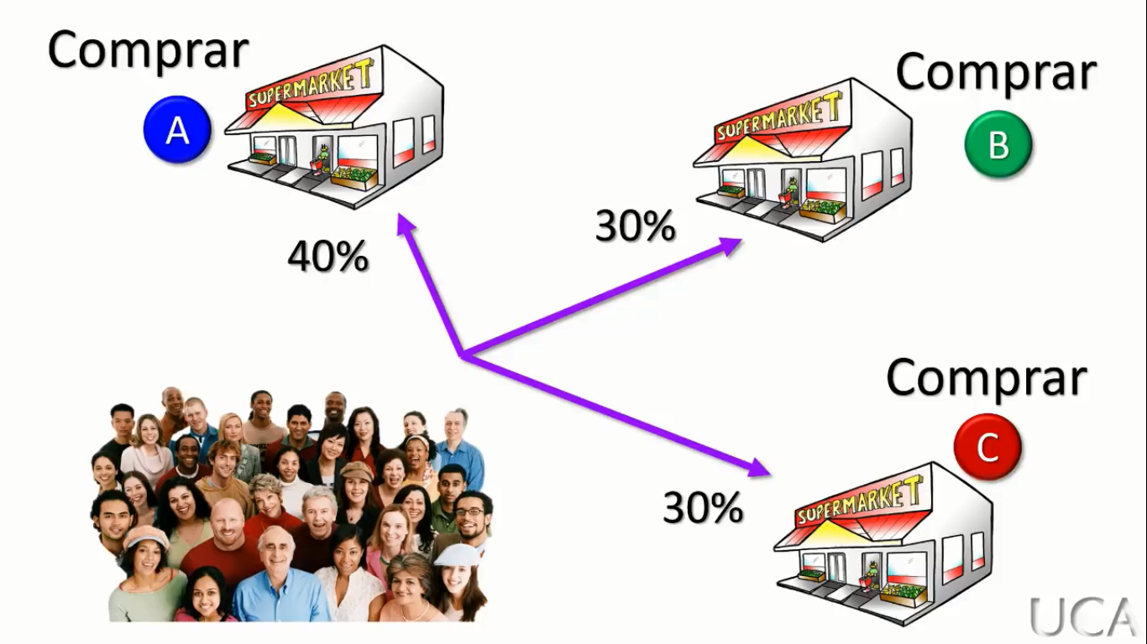


Slide 4
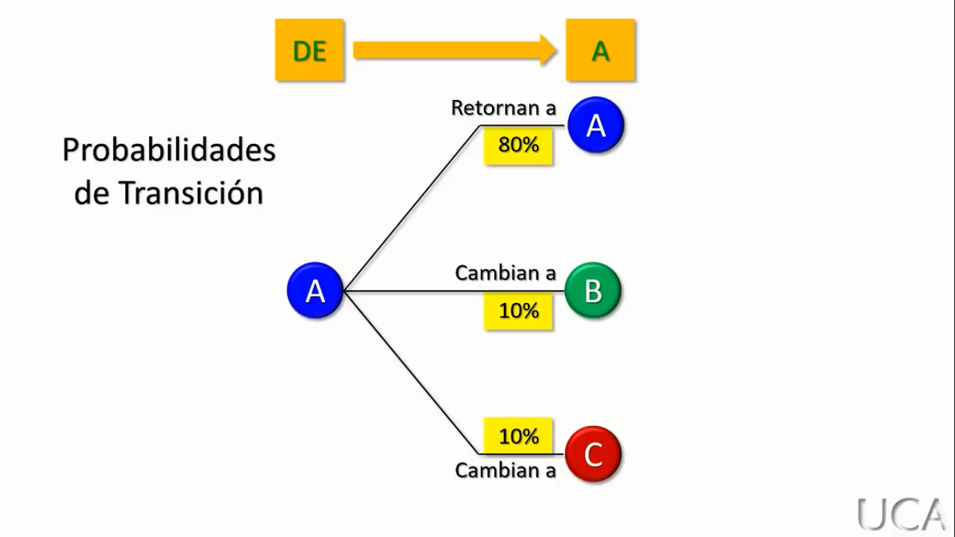
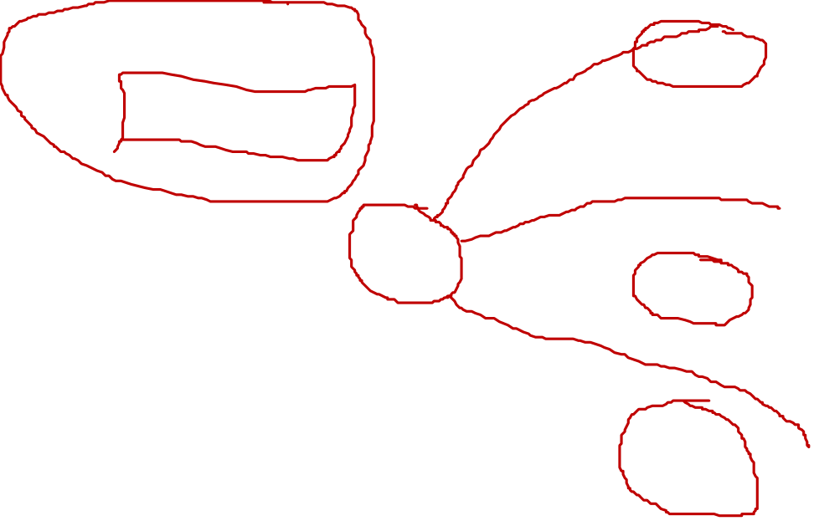

Slide 5
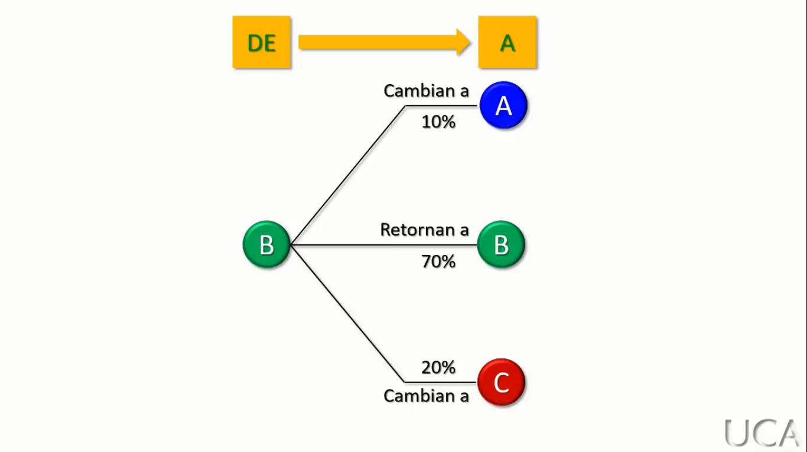
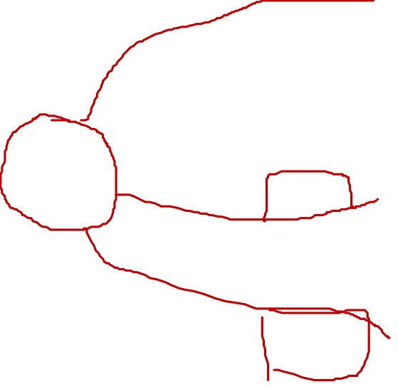

Slide 6
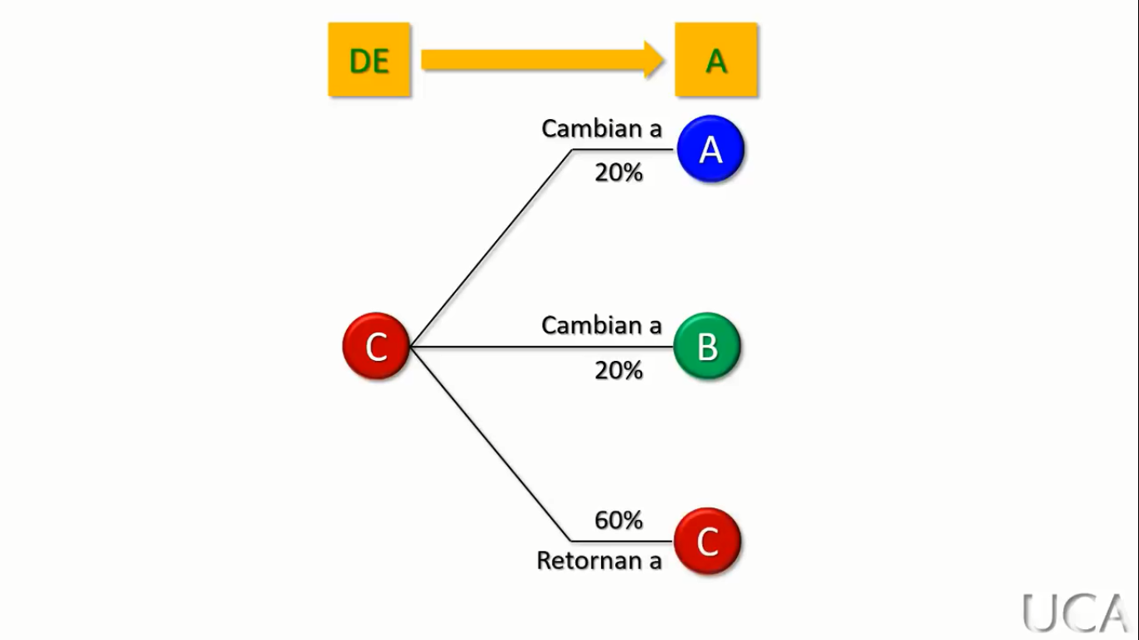
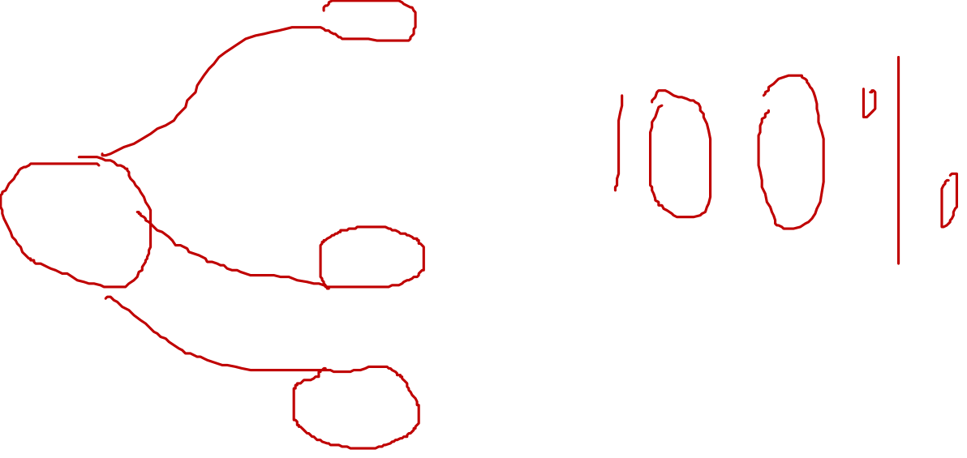

Slide 7
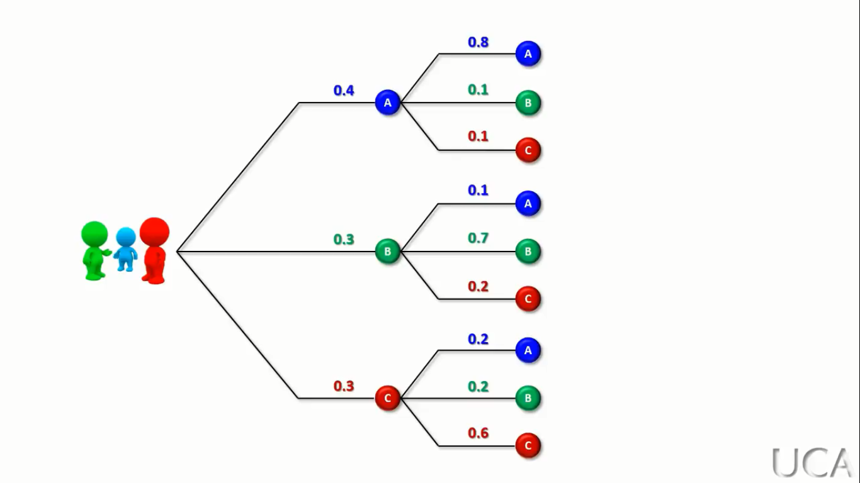
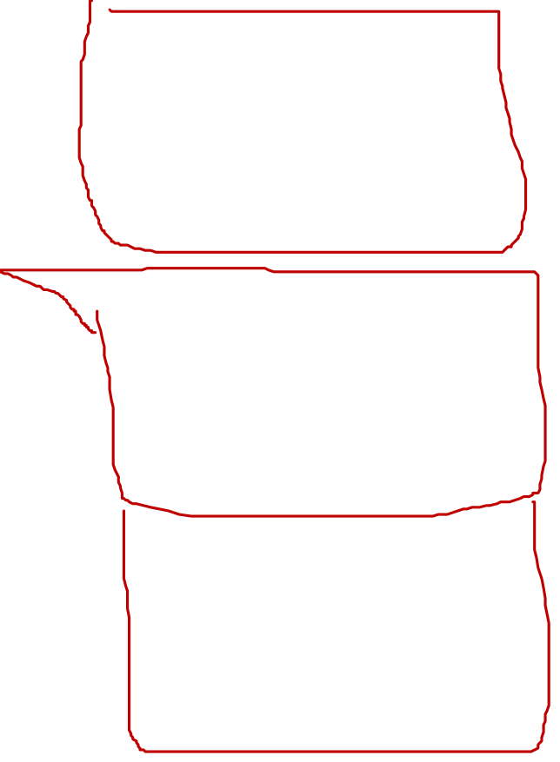

Slide 8
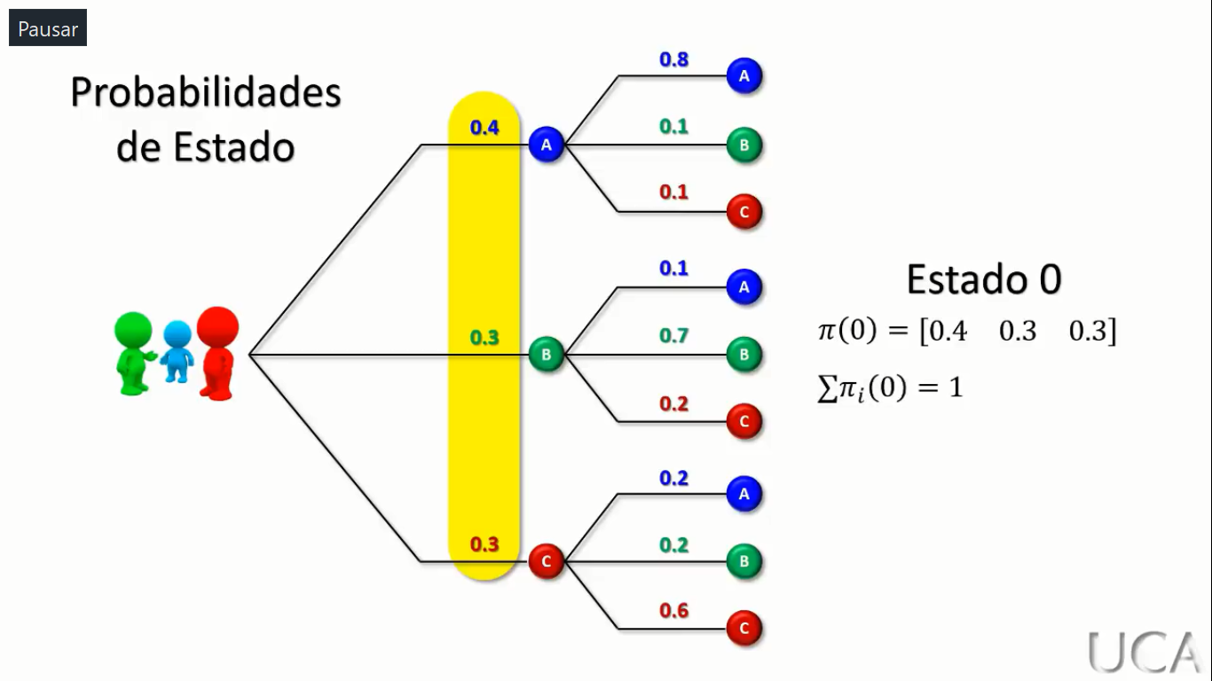
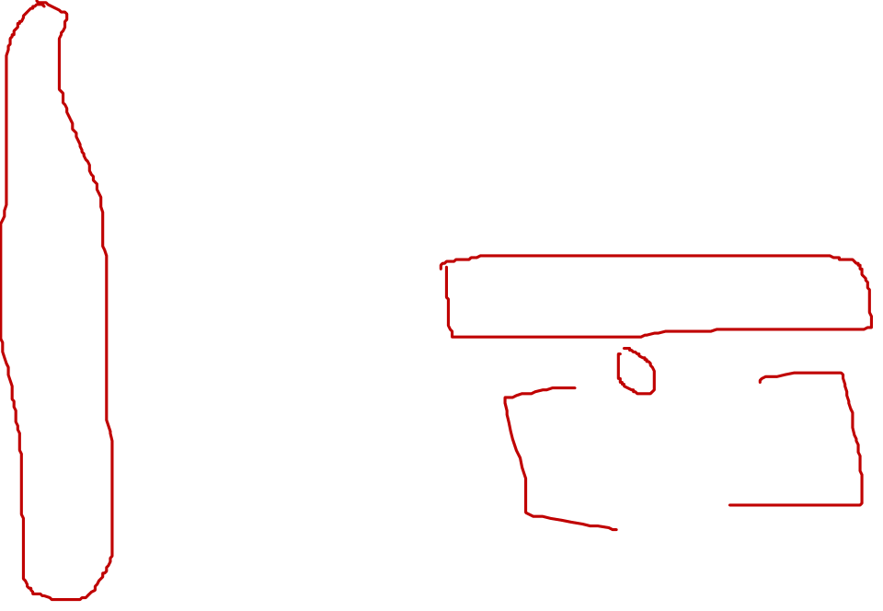

Slide 9
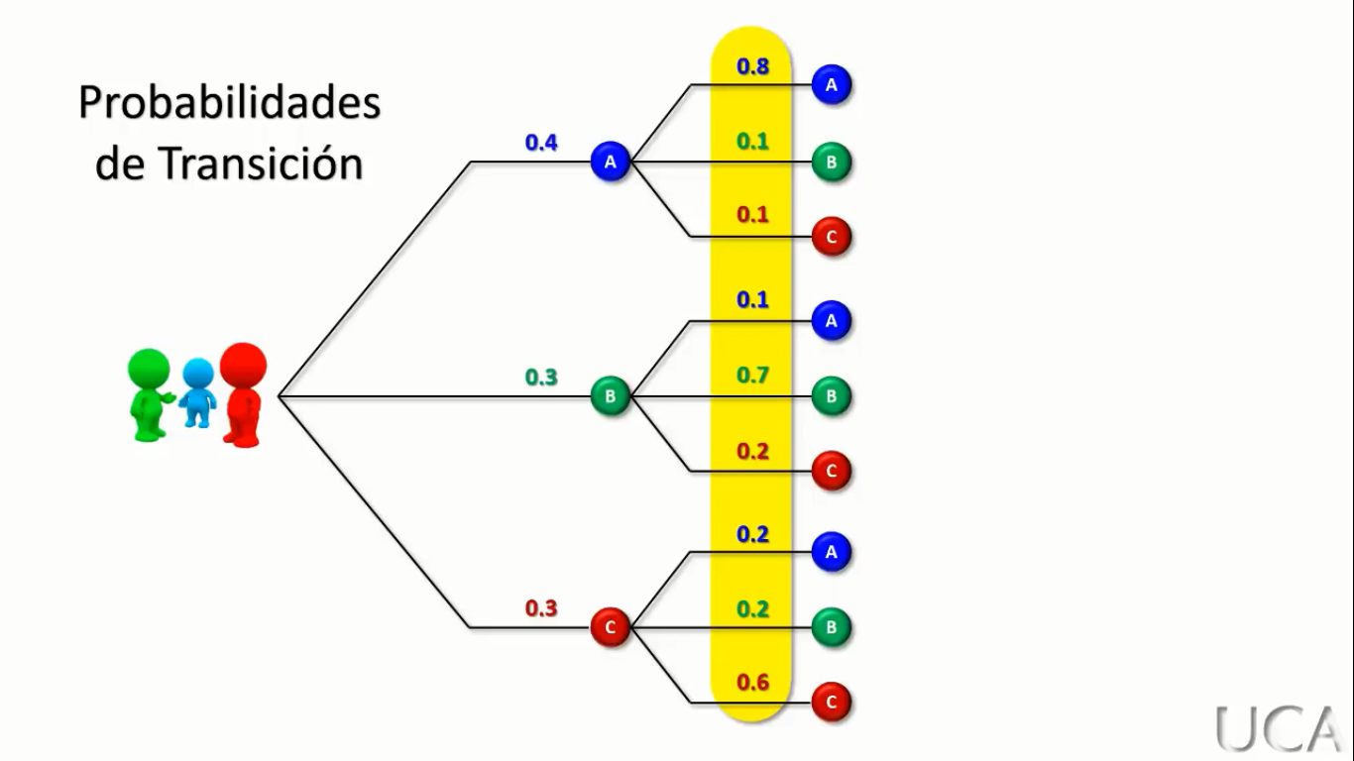

Slide 11
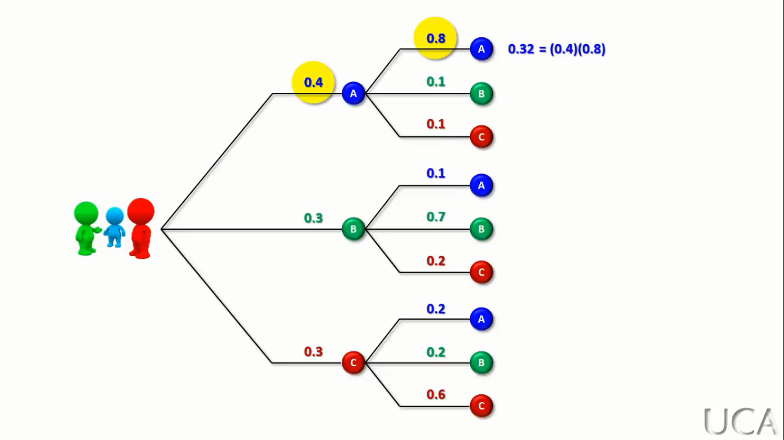


Slide 12
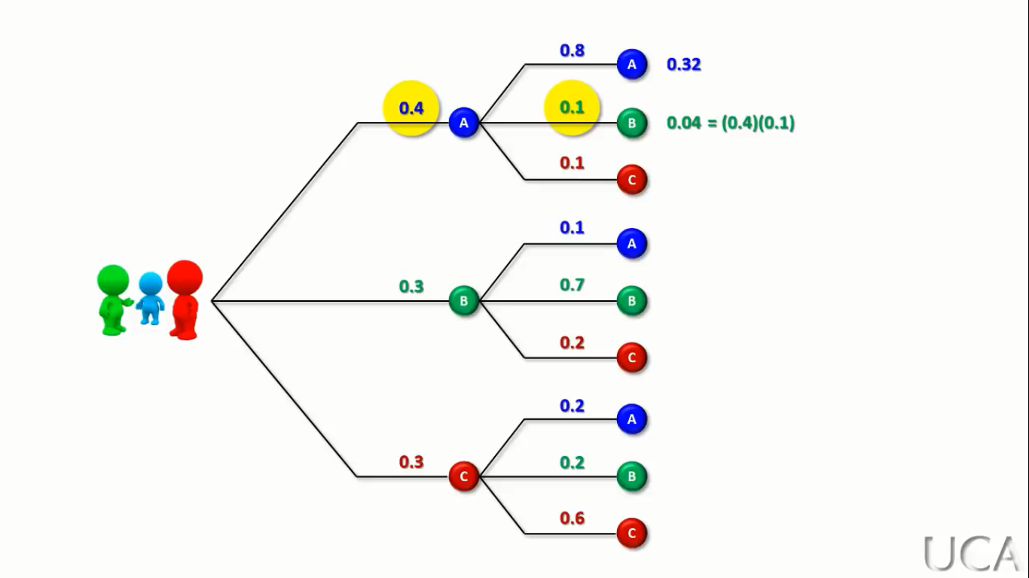
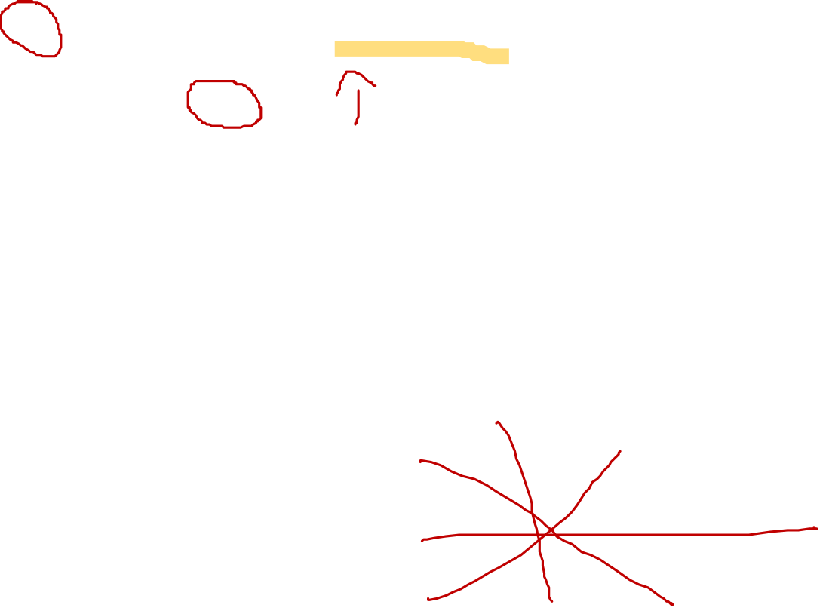

Slide 13
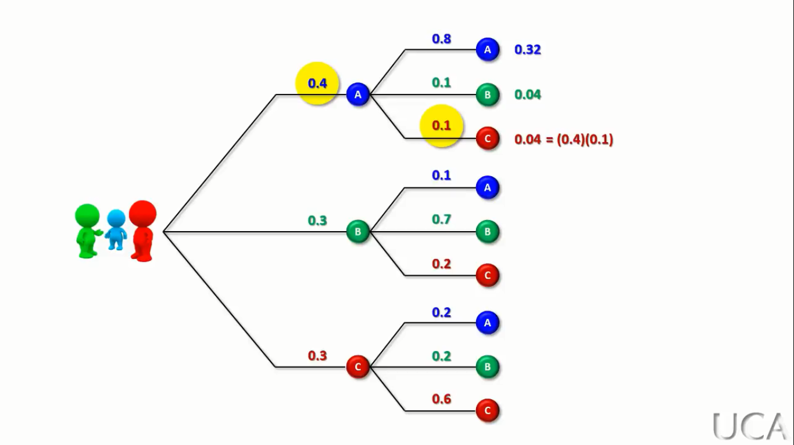


Slide 14
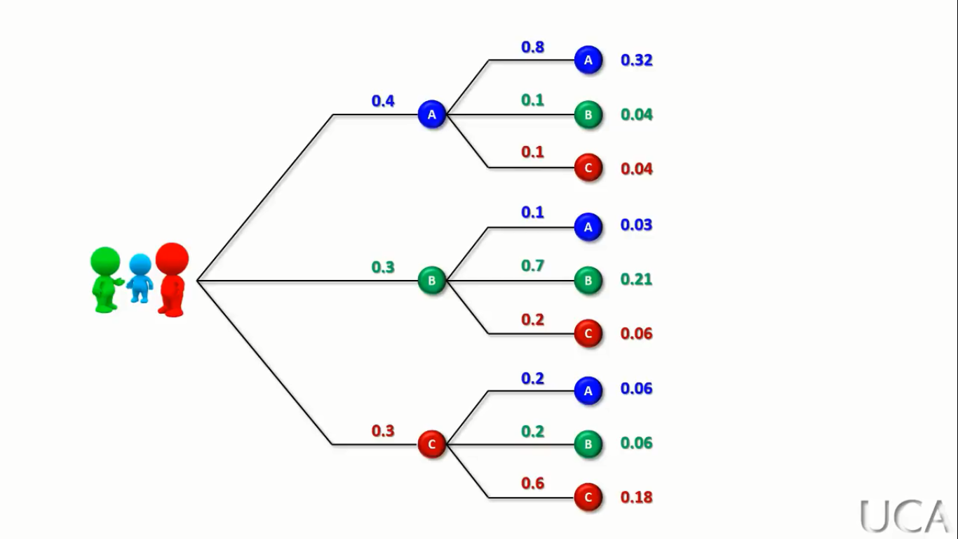


Slide 15
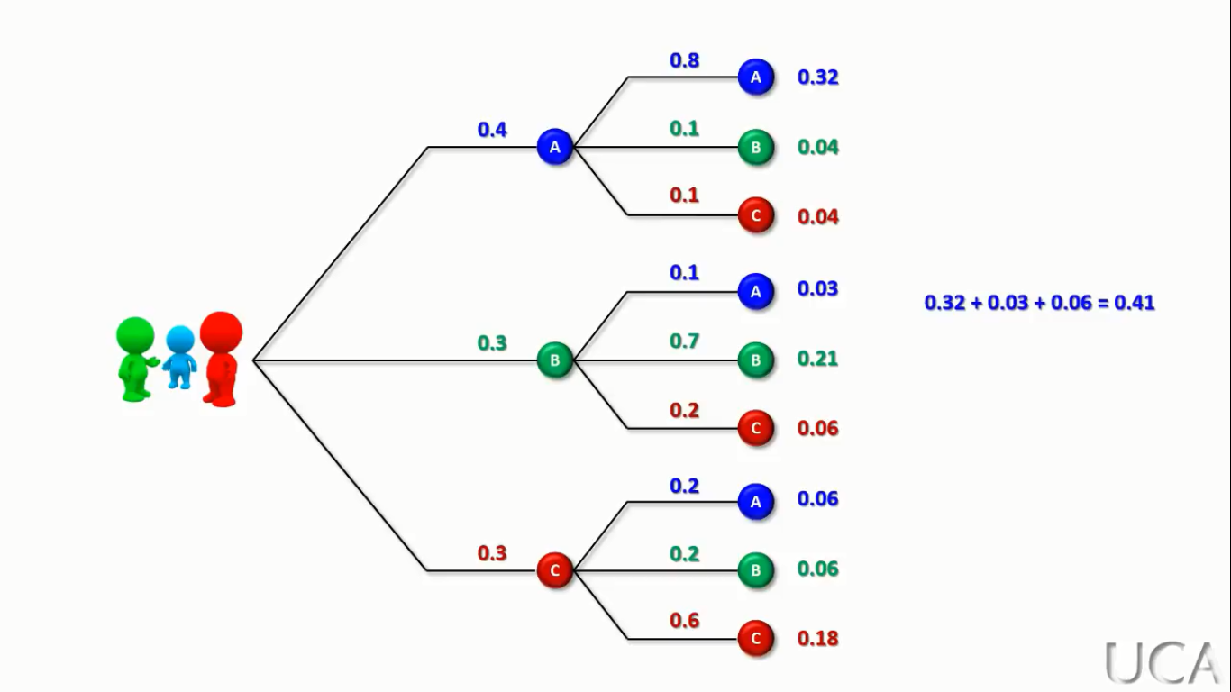
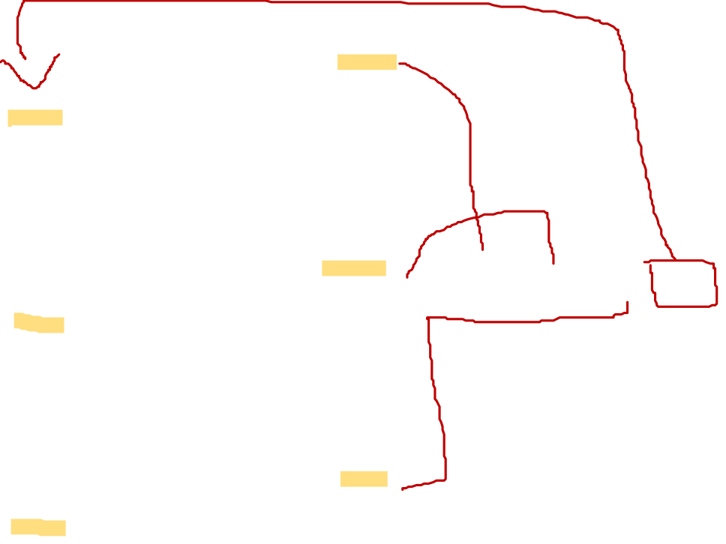
Probabilidad de comparar en el supermercado “A” la siguiente semana

Slide 16
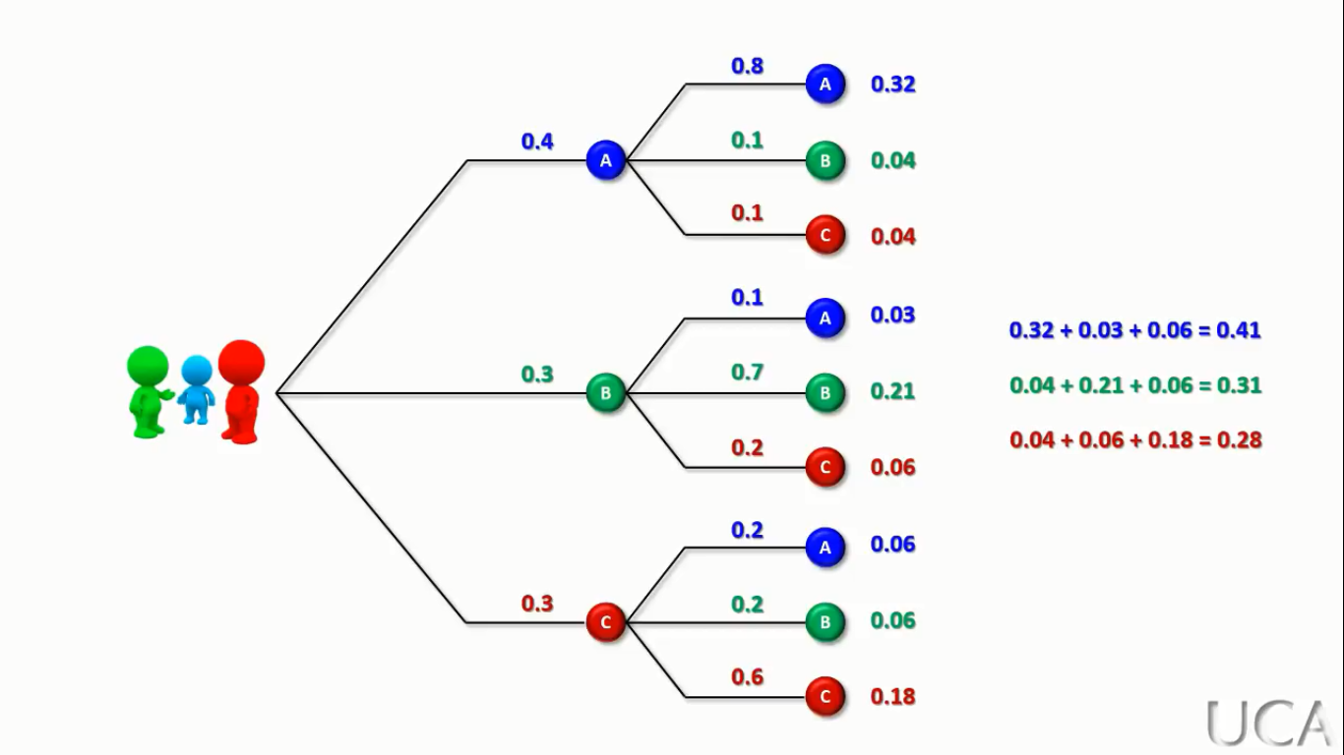
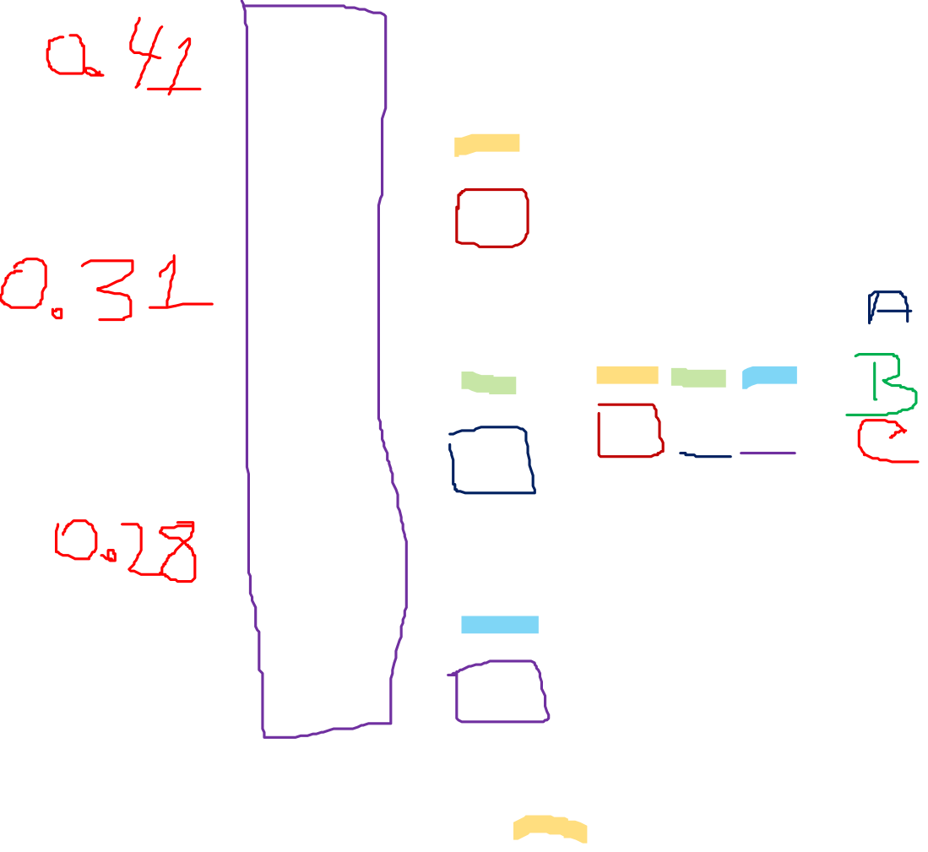

Slide 17
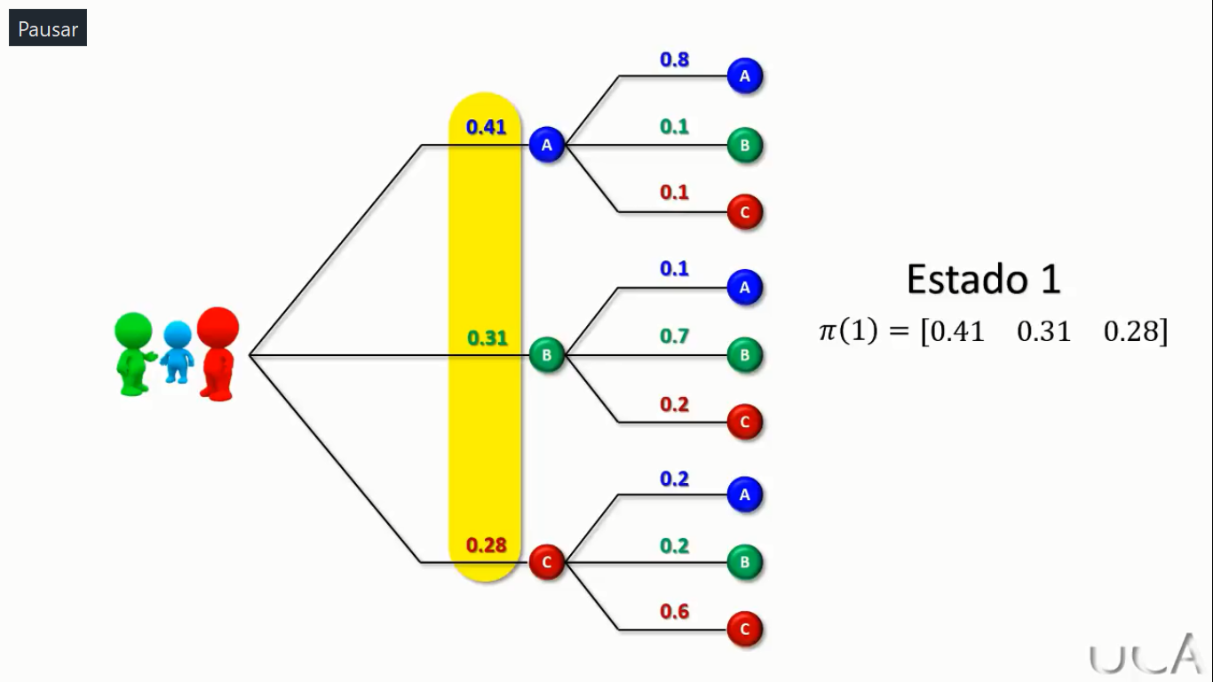
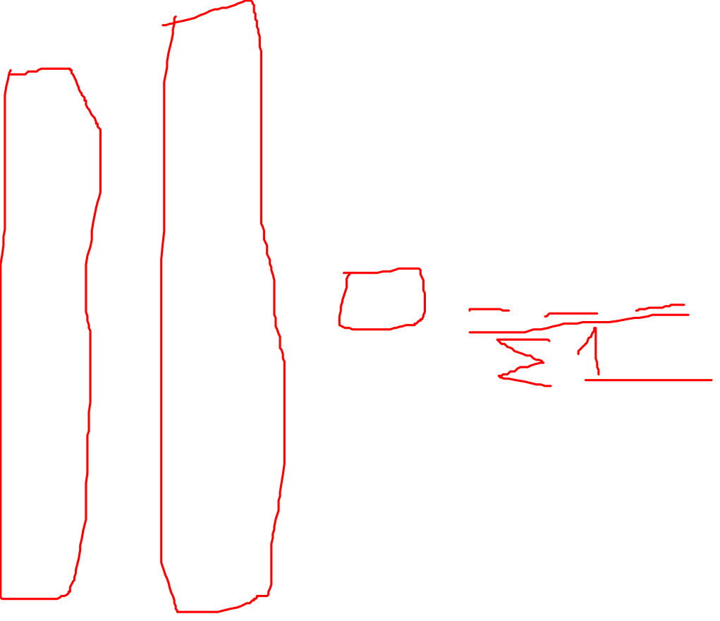

Slide 18
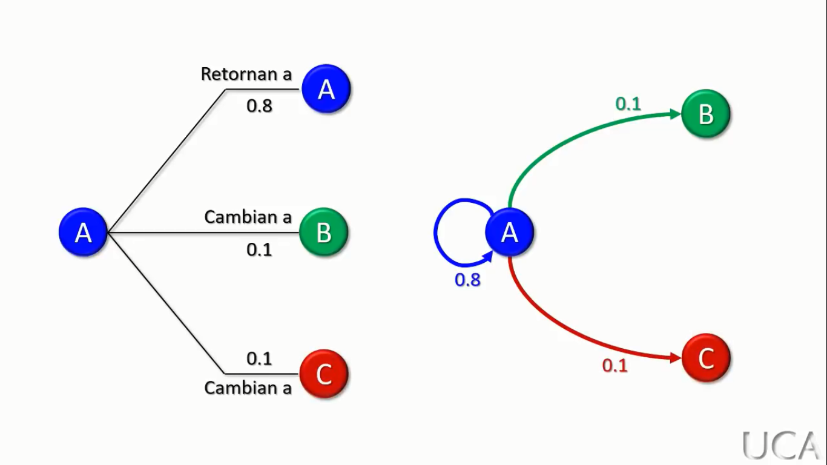
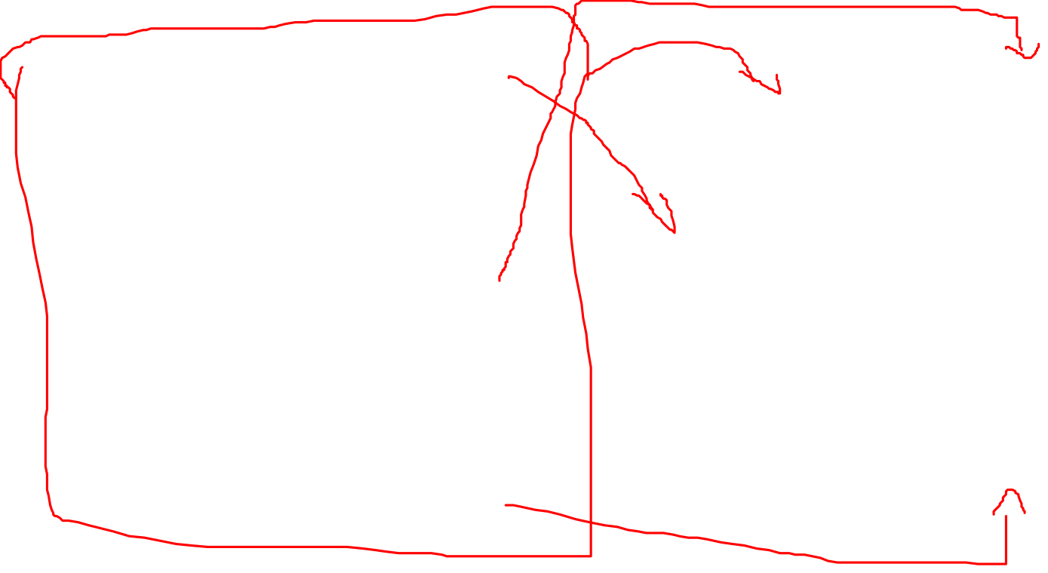
Representación usando Grafos

Slide 19
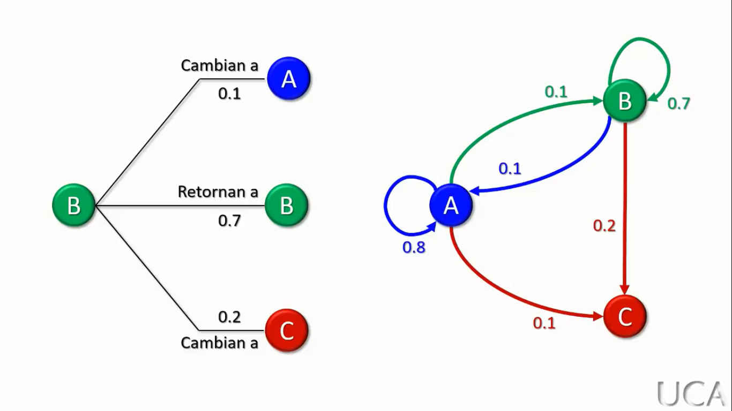
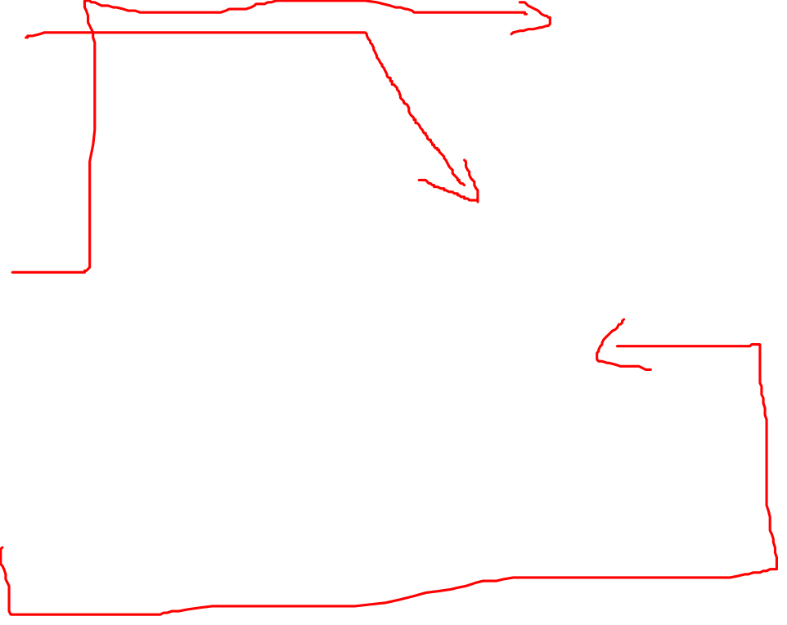
Representación usando Grafos

Slide 20
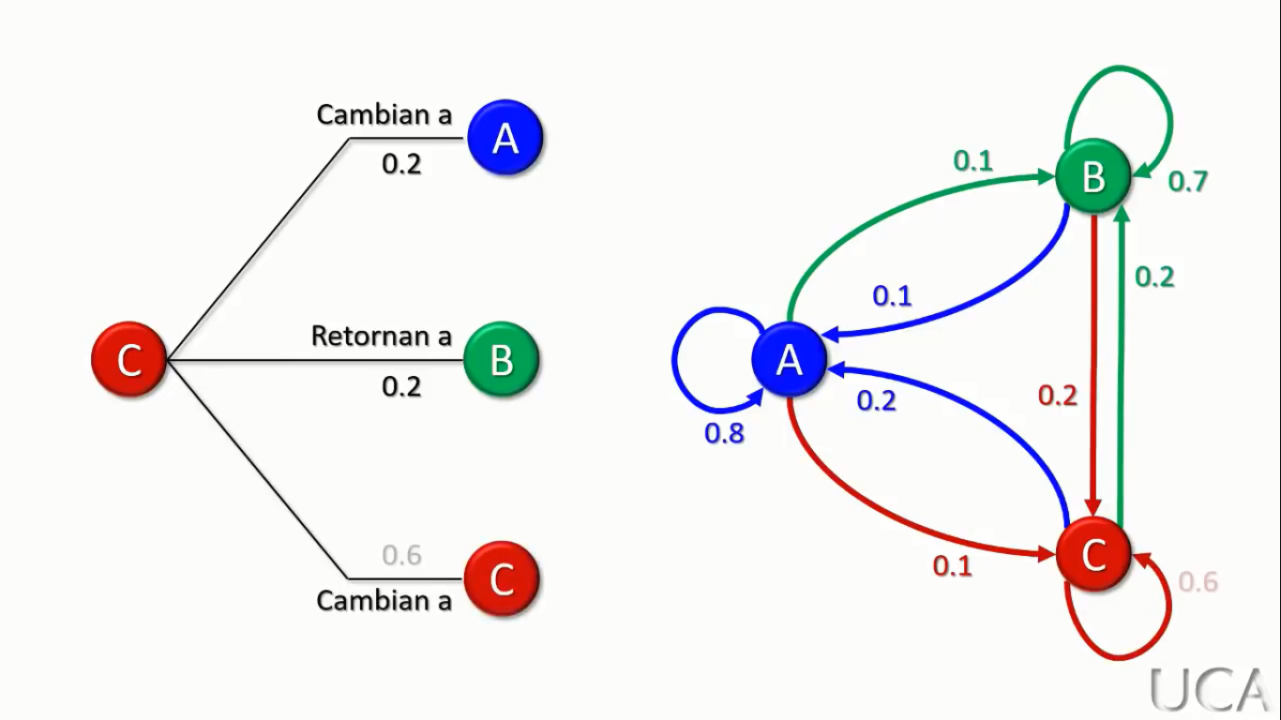
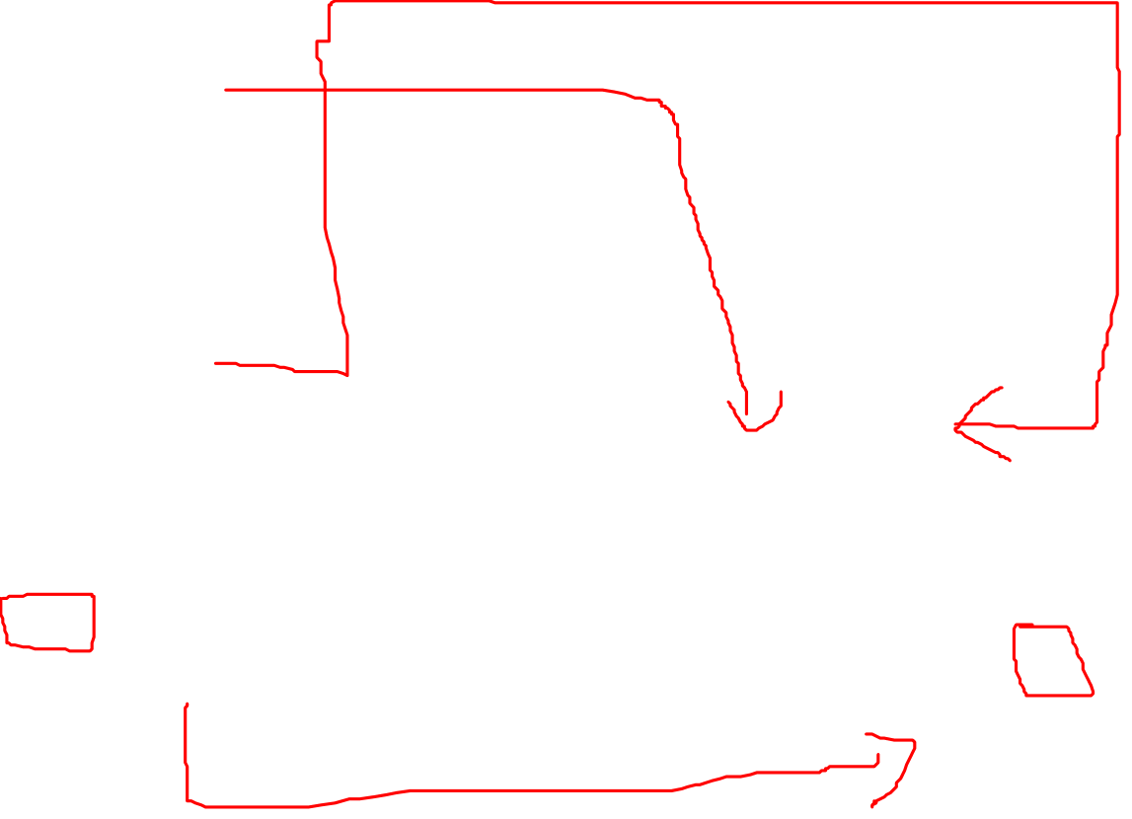
Representación usando Grafos

Slide 21
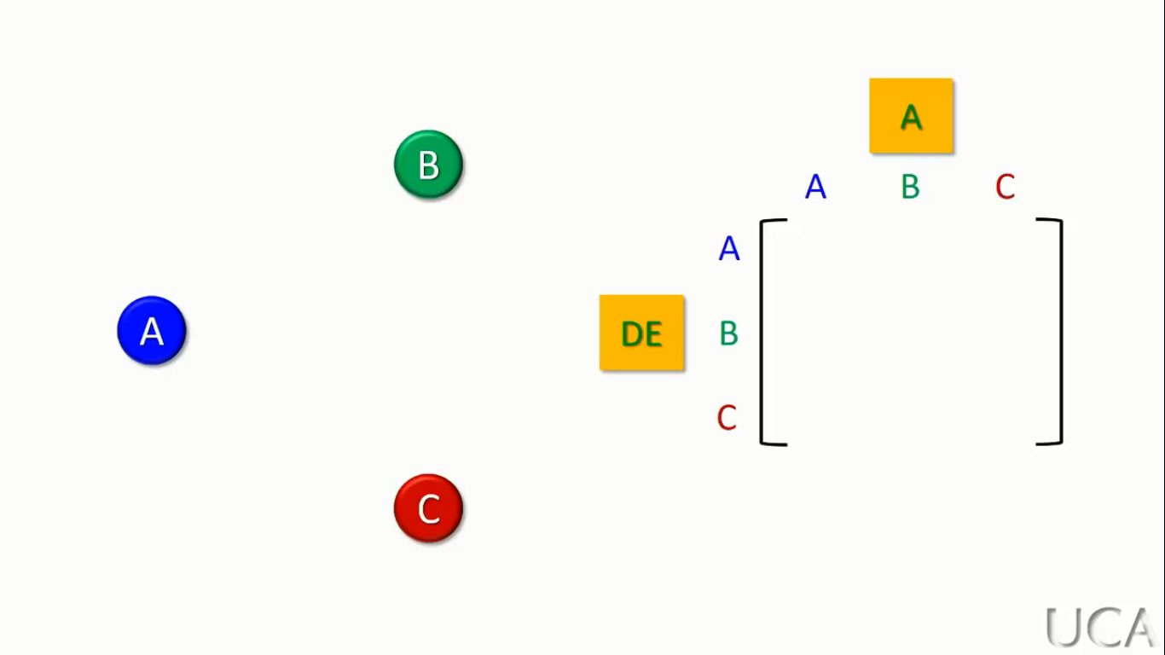
Grafos a matriz

Slide 22
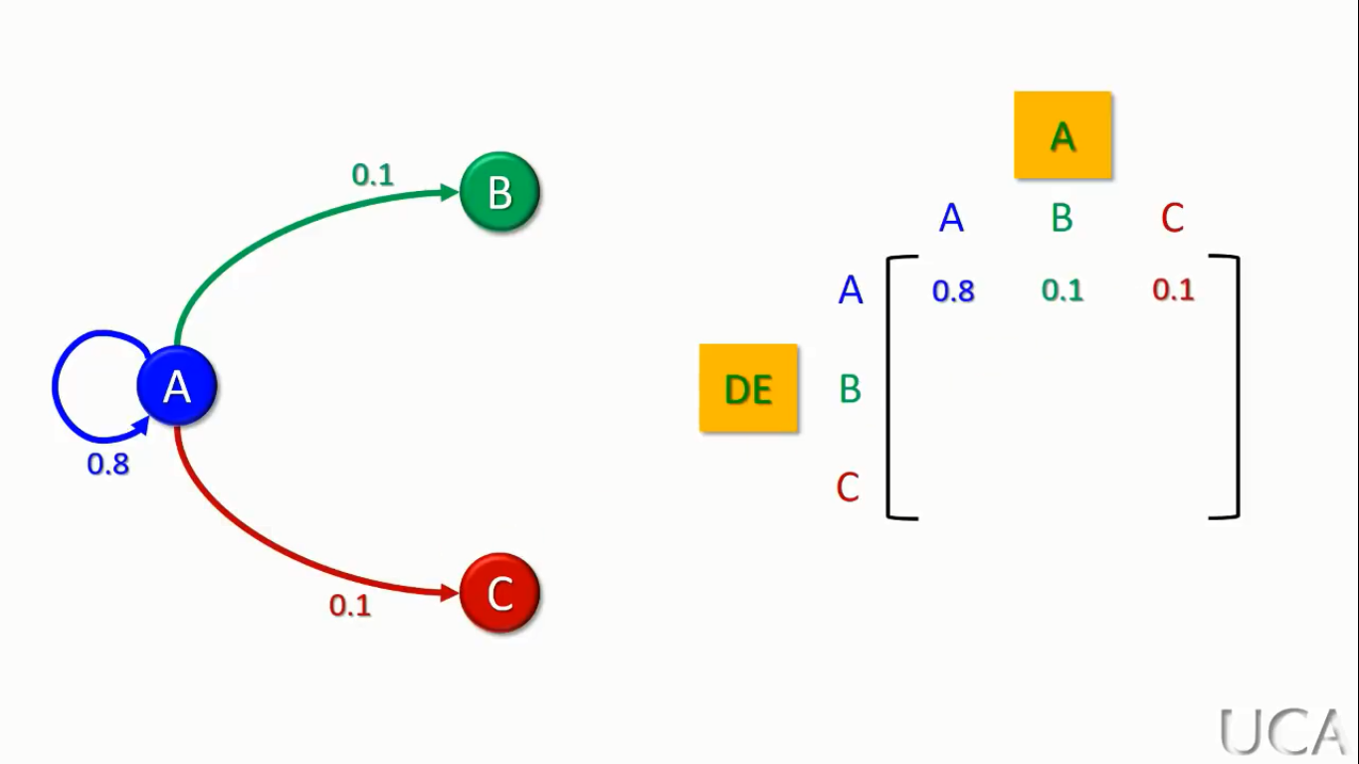

Grafos a matriz

Slide 23
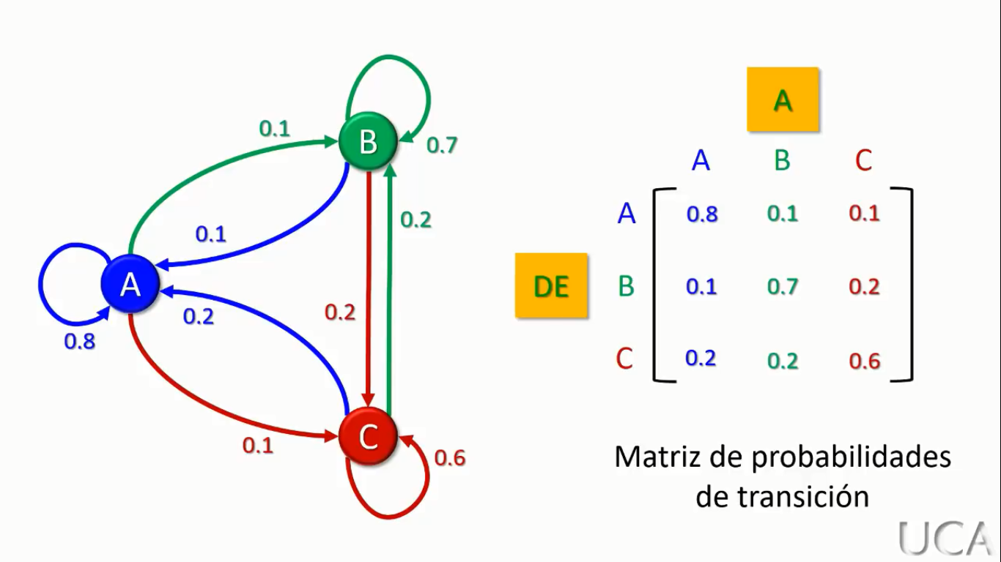
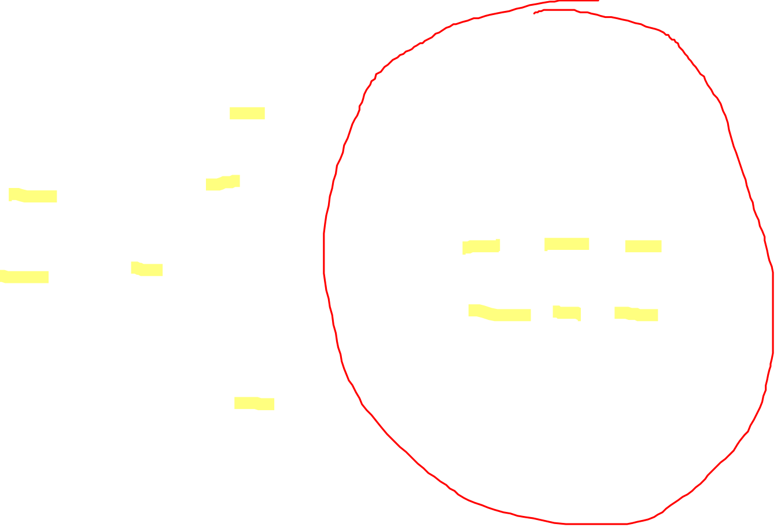
Grafos a matriz

Slide 24
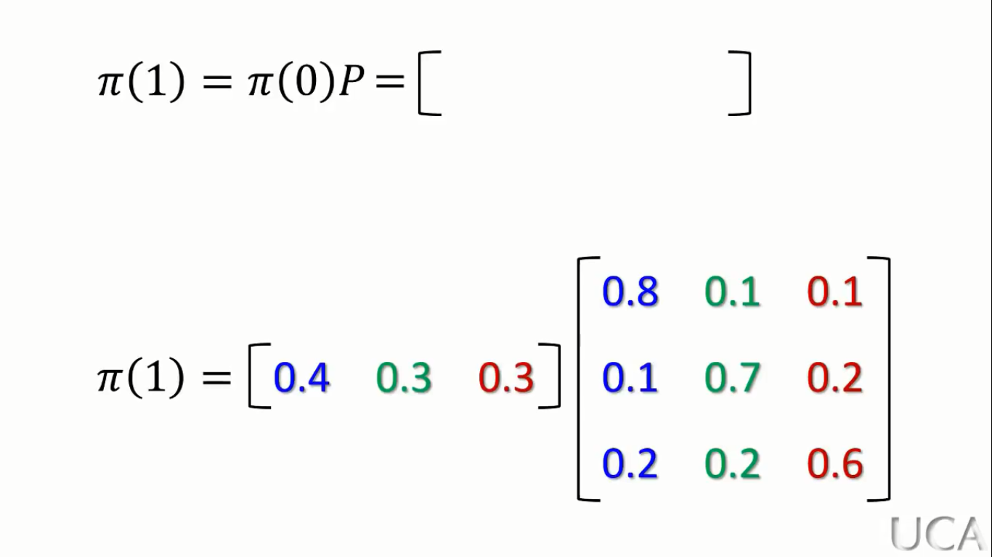
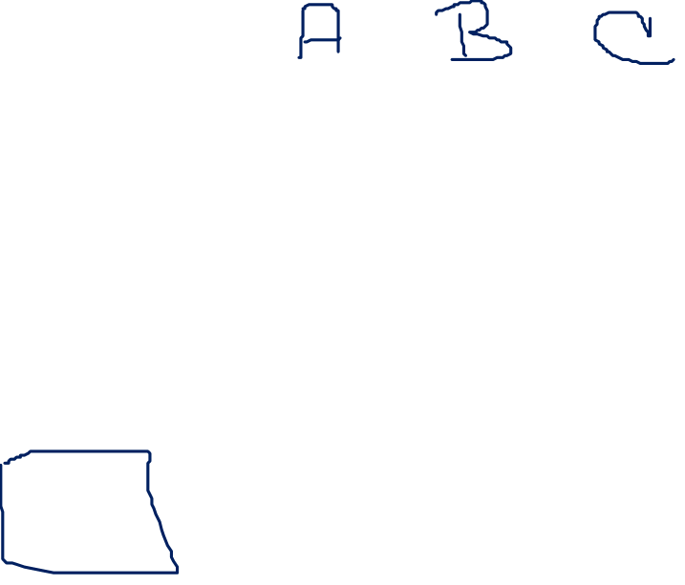
Cálculo de la probabilidad de compra en la siguiente semana usando matriz

Slide 25
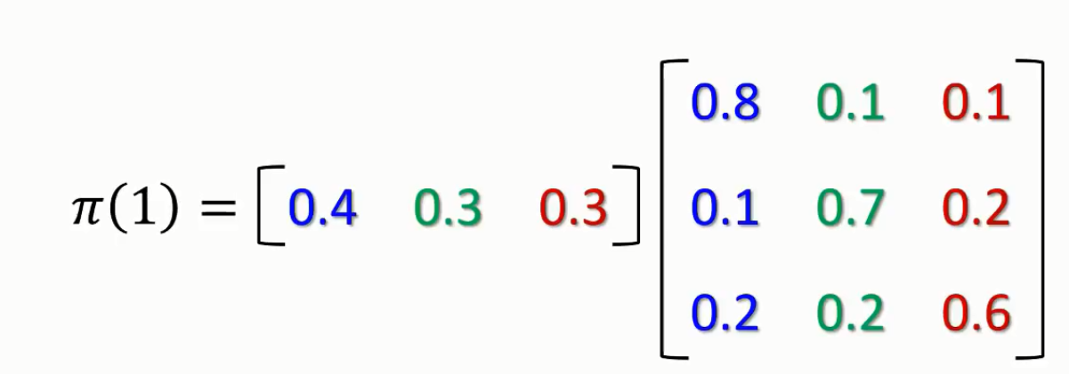
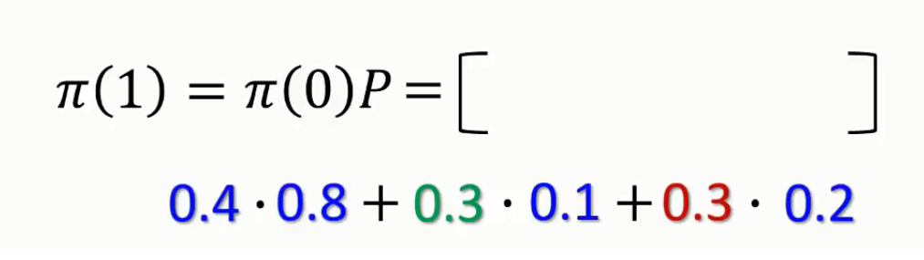

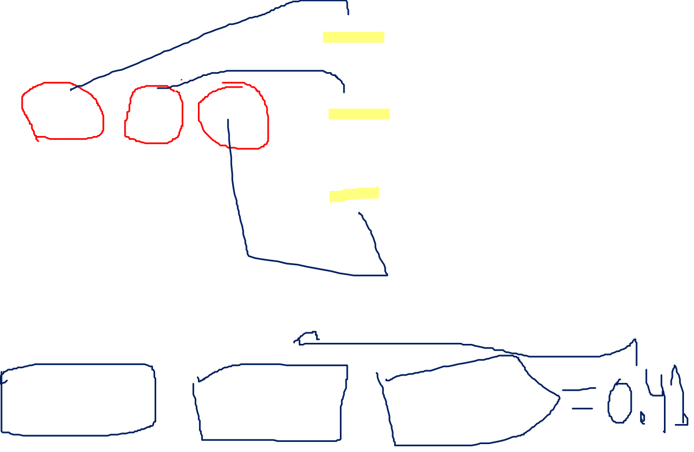
Cálculo de la probabilidad de compra en la siguiente semana usando matriz

Slide 26
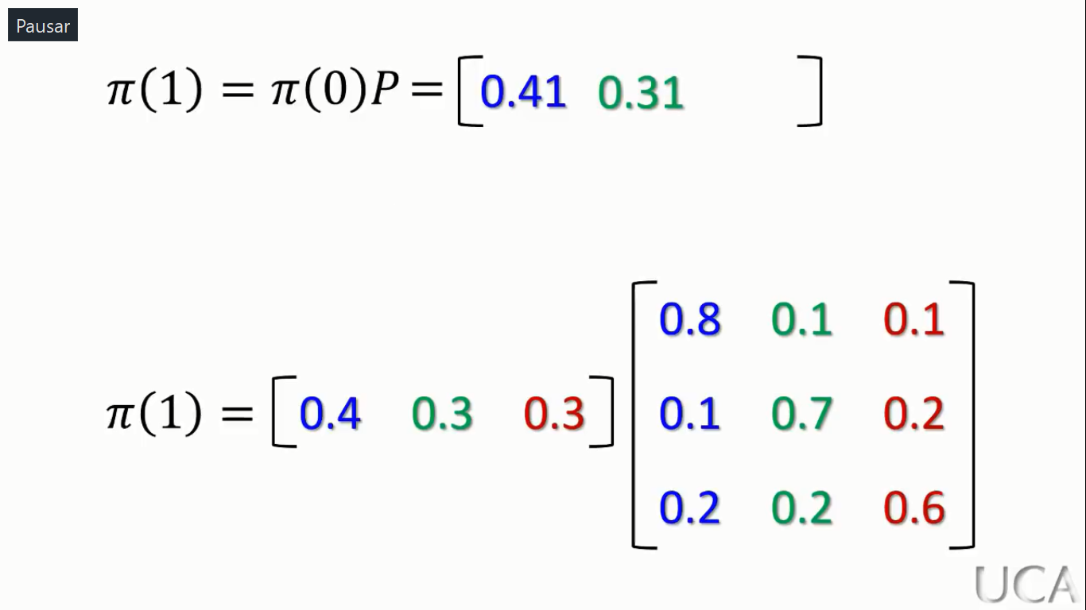
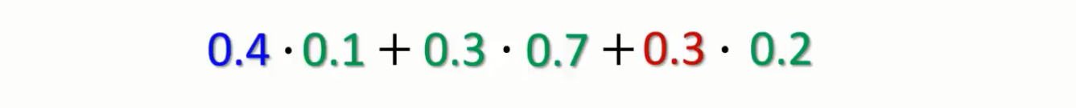
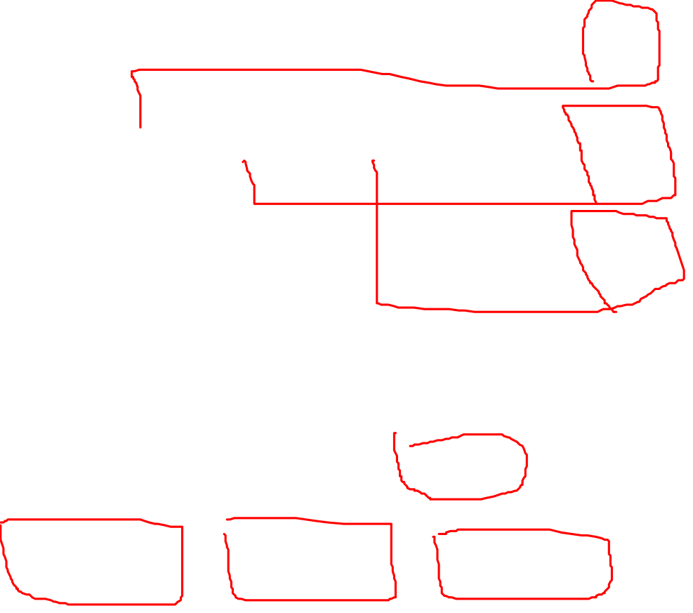
Cálculo de la probabilidad de compra en la siguiente semana usando matriz

Slide 27
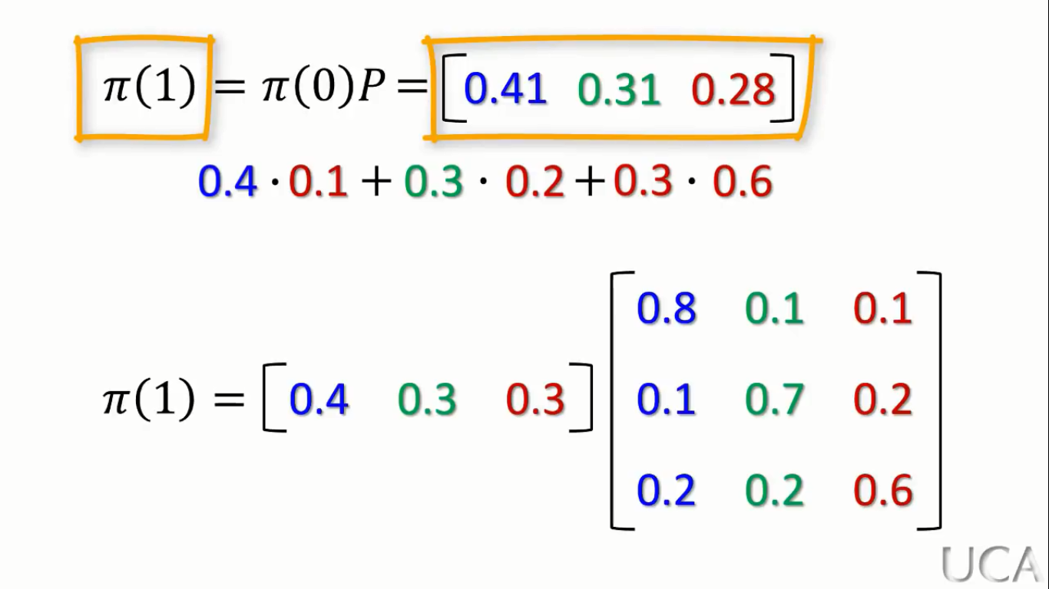
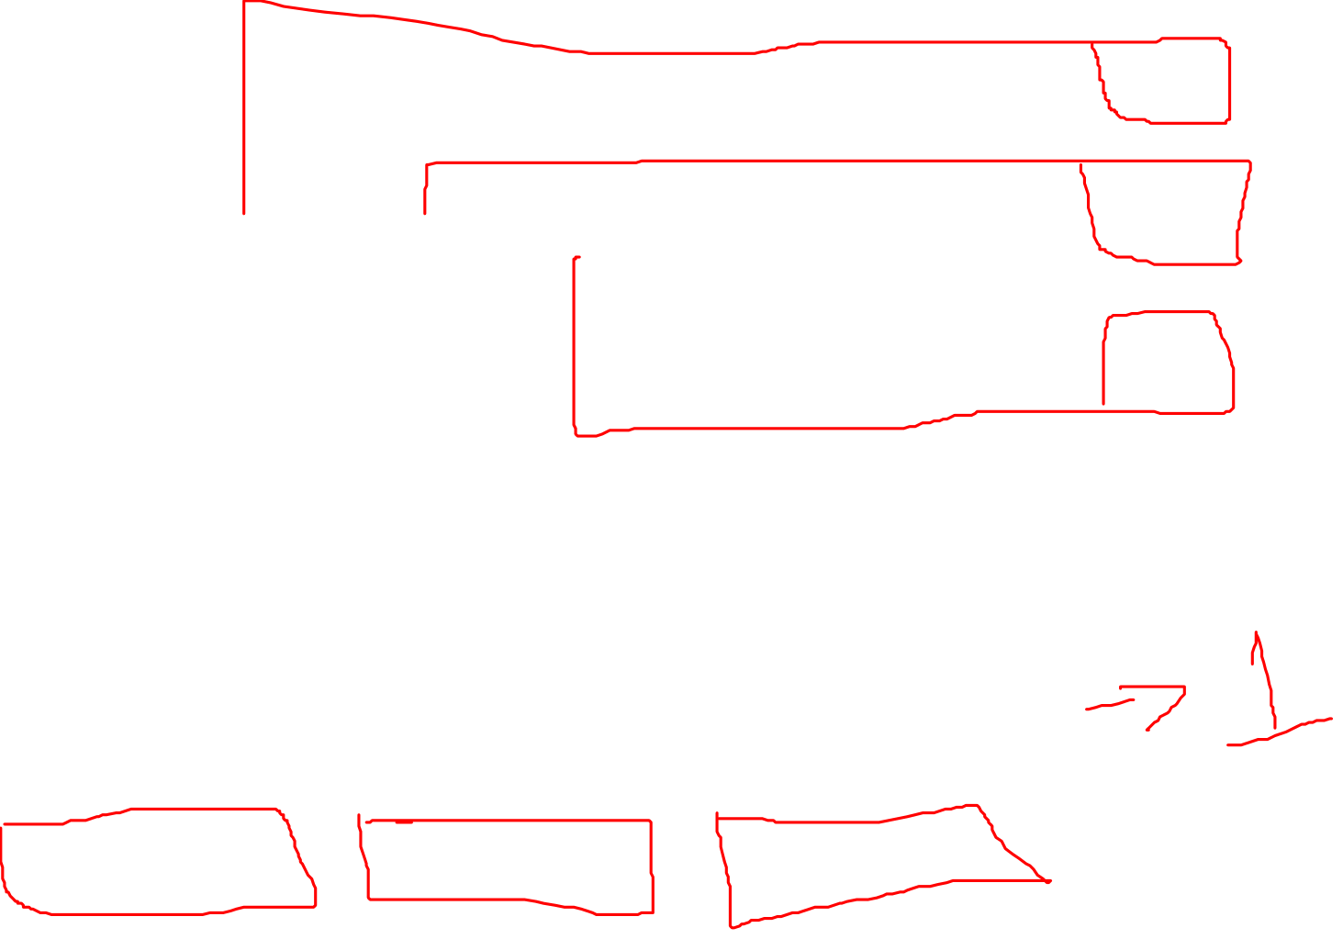

Slide 28


Predicciones a futuro usando Markov
$π$(n) = $π$(0) $P^{n}$
Si deseamos encontrar la tercera predicción nos quedaría:
3
0.8 0.1 0.1
0.1 0.7 0.2
0.2 0.2 0.6
$π$(3) = [ 0.4 0.3 0.3]

Slide 29


3
0.8 0.1 0.1
0.1 0.7 0.2
0.2 0.2 0.6
$π$(3) = [ 0.4 0.3 0.3]
Para resolver esto antes debemos encontrar el valor de la matriz al cubo, para ello aplicamos las reglas de potencia de matrices que derivan en multiplicación de matrices. Si tenemos una matriz $P^{3}$ para resolverla antes hay que resolver $P^{3}$ = $P^{2}$ * P, lo que nos lleva a encontrar previamente $P^{2}$ = P * P, por lo cual multiplicaremos la matriz por sí misma y el resultado lo multiplicaremos por la matriz original, hasta ese momento habremos encontrado la matriz $P^{3}$

Slide 30


0.8 0.1 0.1
0.1 0.7 0.2
0.2 0.2 0.6
0.8 0.1 0.1
0.1 0.7 0.2
0.2 0.2 0.6
$P^{2}$ =
*
2
$P^{2}$ (1,1) = ( 0.8 * 0.8 ) + ( 0.1 * 0.1 ) + ( 0.1 * 0.2 ) = 0.67
0.67
$P^{2}$ =

Slide 31
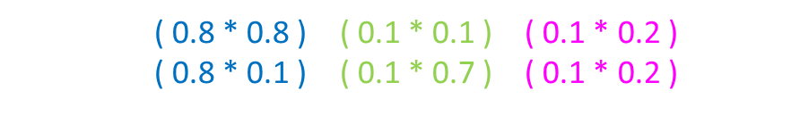
0.8 0.1 0.1
0.1 0.7 0.2
0.2 0.2 0.6
0.8 0.1 0.1
0.1 0.7 0.2
0.2 0.2 0.6
$P^{2}$ =
*
2
$P^{2}$ (1,1) = ( 0.8 * 0.8 ) + ( 0.1 * 0.1 ) + ( 0.1 * 0.2 ) = 0.67
$P^{2}$ (1,2) = ( 0.8 * 0.1 ) + ( 0.1 * 0.7 ) + ( 0.1 * 0.2 ) = 0.17
0.67 0.17
$P^{2}$ =

Slide 32
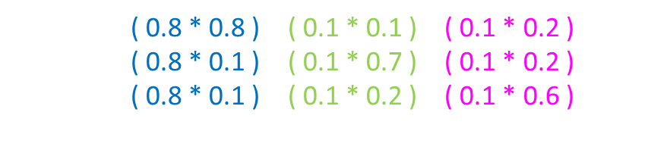
0.8 0.1 0.1
0.1 0.7 0.2
0.2 0.2 0.6
0.8 0.1 0.1
0.1 0.7 0.2
0.2 0.2 0.6
$P^{2}$ =
*
2
$P^{2}$ (1,1) = ( 0.8 * 0.8 ) + ( 0.1 * 0.1 ) + ( 0.1 * 0.2 ) = 0.67
$P^{2}$ (1,2) = ( 0.8 * 0.1 ) + ( 0.1 * 0.7 ) + ( 0.1 * 0.2 ) = 0.17
$P^{2}$ (1,3) = ( 0.8 * 0.1 ) + ( 0.1 * 0.2 ) + ( 0.1 * 0.6 ) = 0.16
0.67 0.17 0.16
$P^{2}$ =

Slide 33
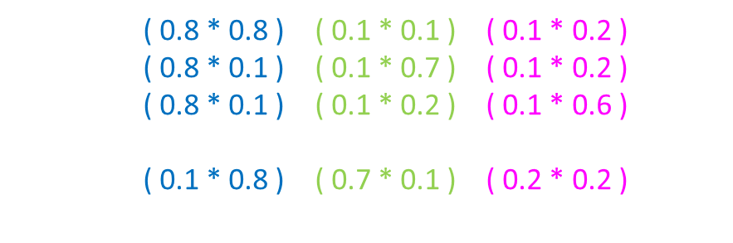
0.8 0.1 0.1
0.1 0.7 0.2
0.2 0.2 0.6
0.8 0.1 0.1
0.1 0.7 0.2
0.2 0.2 0.6
$P^{2}$ =
*
2
$P^{2}$ (1,1) = ( 0.8 * 0.8 ) + ( 0.1 * 0.1 ) + ( 0.1 * 0.2 ) = 0.67
$P^{2}$ (1,2) = ( 0.8 * 0.1 ) + ( 0.1 * 0.7 ) + ( 0.1 * 0.2 ) = 0.17
$P^{2}$ (1,3) = ( 0.8 * 0.1 ) + ( 0.1 * 0.2 ) + ( 0.1 * 0.6 ) = 0.16
$P^{2}$ (2,1) = ( 0.1 * 0.8 ) + ( 0.7 * 0.1 ) + ( 0.2 * 0.2 ) = 0.19
0.67 0.17 0.16
0.19
$P^{2}$ =

Slide 34

0.8 0.1 0.1
0.1 0.7 0.2
0.2 0.2 0.6
0.8 0.1 0.1
0.1 0.7 0.2
0.2 0.2 0.6
$P^{2}$ =
*
2
$P^{2}$ (1,1) = ( 0.8 * 0.8 ) + ( 0.1 * 0.1 ) + ( 0.1 * 0.2 ) = 0.67
$P^{2}$ (1,2) = ( 0.8 * 0.1 ) + ( 0.1 * 0.7 ) + ( 0.1 * 0.2 ) = 0.17
$P^{2}$ (1,3) = ( 0.8 * 0.1 ) + ( 0.1 * 0.2 ) + ( 0.1 * 0.6 ) = 0.16
$P^{2}$ (2,1) = ( 0.1 * 0.8 ) + ( 0.7 * 0.1 ) + ( 0.2 * 0.2 ) = 0.19
$P^{2}$ (2,2) = ( 0.1 * 0.1 ) + ( 0.7 * 0.7 ) + ( 0.2 * 0.2 ) = 0.54
0.67 0.17 0.16
0.19 0.54
$P^{2}$ =

Slide 35

0.8 0.1 0.1
0.1 0.7 0.2
0.2 0.2 0.6
0.8 0.1 0.1
0.1 0.7 0.2
0.2 0.2 0.6
$P^{2}$ =
*
2
$P^{2}$ (1,1) = ( 0.8 * 0.8 ) + ( 0.1 * 0.1 ) + ( 0.1 * 0.2 ) = 0.67
$P^{2}$ (1,2) = ( 0.8 * 0.1 ) + ( 0.1 * 0.7 ) + ( 0.1 * 0.2 ) = 0.17
$P^{2}$ (1,3) = ( 0.8 * 0.1 ) + ( 0.1 * 0.2 ) + ( 0.1 * 0.6 ) = 0.16
$P^{2}$ (2,1) = ( 0.1 * 0.8 ) + ( 0.7 * 0.1 ) + ( 0.2 * 0.2 ) = 0.19
$P^{2}$ (2,2) = ( 0.1 * 0.1 ) + ( 0.7 * 0.7 ) + ( 0.2 * 0.2 ) = 0.54
$P^{2}$ (2,3) = ( 0.1 * 0.1 ) + ( 0.7 * 0.2 ) + ( 0.2 * 0.6 ) = 0.27
0.67 0.17 0.16
0.19 0.54 0.27
$P^{2}$ =

Slide 36


0.8 0.1 0.1
0.1 0.7 0.2
0.2 0.2 0.6
0.8 0.1 0.1
0.1 0.7 0.2
0.2 0.2 0.6
$P^{2}$ =
*
2
$P^{2}$ (1,1) = ( 0.8 * 0.8 ) + ( 0.1 * 0.1 ) + ( 0.1 * 0.2 ) = 0.67
$P^{2}$ (1,2) = ( 0.8 * 0.1 ) + ( 0.1 * 0.7 ) + ( 0.1 * 0.2 ) = 0.17
$P^{2}$ (1,3) = ( 0.8 * 0.1 ) + ( 0.1 * 0.2 ) + ( 0.1 * 0.6 ) = 0.16
$P^{2}$ (2,1) = ( 0.1 * 0.8 ) + ( 0.7 * 0.1 ) + ( 0.2 * 0.2 ) = 0.19
$P^{2}$ (2,2) = ( 0.1 * 0.1 ) + ( 0.7 * 0.7 ) + ( 0.2 * 0.2 ) = 0.54
$P^{2}$ (2,3) = ( 0.1 * 0.1 ) + ( 0.7 * 0.2 ) + ( 0.2 * 0.6 ) = 0.27
$P^{2}$ (3,1) = ( 0.2 * 0.8 ) + ( 0.2 * 0.1 ) + ( 0.6 * 0.2 ) = 0.3
0.67 0.17 0.16
0.19 0.54 0.27
0.3
$P^{2}$ =

Slide 37

0.8 0.1 0.1
0.1 0.7 0.2
0.2 0.2 0.6
0.8 0.1 0.1
0.1 0.7 0.2
0.2 0.2 0.6
$P^{2}$ =
*
2
$P^{2}$ (1,1) = ( 0.8 * 0.8 ) + ( 0.1 * 0.1 ) + ( 0.1 * 0.2 ) = 0.67
$P^{2}$ (1,2) = ( 0.8 * 0.1 ) + ( 0.1 * 0.7 ) + ( 0.1 * 0.2 ) = 0.17
$P^{2}$ (1,3) = ( 0.8 * 0.1 ) + ( 0.1 * 0.2 ) + ( 0.1 * 0.6 ) = 0.16
$P^{2}$ (2,1) = ( 0.1 * 0.8 ) + ( 0.7 * 0.1 ) + ( 0.2 * 0.2 ) = 0.19
$P^{2}$ (2,2) = ( 0.1 * 0.1 ) + ( 0.7 * 0.7 ) + ( 0.2 * 0.2 ) = 0.54
$P^{2}$ (2,3) = ( 0.1 * 0.1 ) + ( 0.7 * 0.2 ) + ( 0.2 * 0.6 ) = 0.27
$P^{2}$ (3,1) = ( 0.2 * 0.8 ) + ( 0.2 * 0.1 ) + ( 0.6 * 0.2 ) = 0.3
$P^{2}$ (3,2) = ( 0.2 * 0.1 ) + ( 0.2 * 0.7 ) + ( 0.6 * 0.2 ) = 0.28
0.67 0.17 0.16
0.19 0.54 0.27
0.3 0.28
$P^{2}$ =

Slide 38

0.8 0.1 0.1
0.1 0.7 0.2
0.2 0.2 0.6
0.8 0.1 0.1
0.1 0.7 0.2
0.2 0.2 0.6
$P^{2}$ =
*
2
$P^{2}$ (1,1) = ( 0.8 * 0.8 ) + ( 0.1 * 0.1 ) + ( 0.1 * 0.2 ) = 0.67
$P^{2}$ (1,2) = ( 0.8 * 0.1 ) + ( 0.1 * 0.7 ) + ( 0.1 * 0.2 ) = 0.17
$P^{2}$ (1,3) = ( 0.8 * 0.1 ) + ( 0.1 * 0.2 ) + ( 0.1 * 0.6 ) = 0.16
$P^{2}$ (2,1) = ( 0.1 * 0.8 ) + ( 0.7 * 0.1 ) + ( 0.2 * 0.2 ) = 0.19
$P^{2}$ (2,2) = ( 0.1 * 0.1 ) + ( 0.7 * 0.7 ) + ( 0.2 * 0.2 ) = 0.54
$P^{2}$ (2,3) = ( 0.1 * 0.1 ) + ( 0.7 * 0.2 ) + ( 0.2 * 0.6 ) = 0.27
$P^{2}$ (3,1) = ( 0.2 * 0.8 ) + ( 0.2 * 0.1 ) + ( 0.6 * 0.2 ) = 0.3
$P^{2}$ (3,2) = ( 0.2 * 0.1 ) + ( 0.2 * 0.7 ) + ( 0.6 * 0.2 ) = 0.28
$P^{2}$ (2,3) = ( 0.2 * 0.1 ) + ( 0.2 * 0.2 ) + ( 0.6 * 0.6 ) = 0.42
0.67 0.17 0.16
0.19 0.54 0.27
0.3 0.28 0.42
$P^{2}$ =

Slide 39



Ahora debemos calcular $P^{3}$ = $P^{2}$ * P
2
0.67 0.17 0.16
0.19 0.54 0.27
0.3 0.28 0.42
0.8 0.1 0.1
0.1 0.7 0.2
0.2 0.2 0.6
$P^{3}$ =
*
3
$P^{3}$ (1,1) = ( 0.67 * 0.8 ) + ( 0.17 * 0.1 ) + ( 0.16 * 0.2 ) = 0.585
0.585
$P^{3}$ =

Slide 40

Ahora debemos calcular $P^{3}$ = $P^{2}$ * P
2
0.67 0.17 0.16
0.19 0.54 0.27
0.3 0.28 0.42
0.8 0.1 0.1
0.1 0.7 0.2
0.2 0.2 0.6
$P^{3}$ =
*
3
$P^{3}$(1,1) = ( 0.67 * 0.8 ) + ( 0.17 * 0.1 ) + ( 0.16 * 0.2 ) = 0.585
$P^{3}$(1,2) = ( 0.67 * 0.1 ) + ( 0.17 * 0.7 ) + ( 0.16 * 0.2 ) = 0.218
0.585 0.218
$P^{3}$ =

Slide 41

Ahora debemos calcular $P^{3}$ = $P^{2}$ * P
2
0.67 0.17 0.16
0.19 0.54 0.27
0.3 0.28 0.42
0.8 0.1 0.1
0.1 0.7 0.2
0.2 0.2 0.6
$P^{3}$ =
*
3
$P^{3}$(1,1) = ( 0.67 * 0.8 ) + ( 0.17 * 0.1 ) + ( 0.16 * 0.2 ) = 0.585
$P^{3}$(1,2) = ( 0.67 * 0.1 ) + ( 0.17 * 0.7 ) + ( 0.16 * 0.2 ) = 0.218
$P^{3}$(1,3) = ( 0.67 * 0.1 ) + ( 0.17 * 0.2 ) + ( 0.16 * 0.6 ) = 0.197
0.585 0.218 0.197
$P^{3}$ =

Slide 42

Ahora debemos calcular $P^{3}$ = $P^{2}$ * P
2
0.67 0.17 0.16
0.19 0.54 0.27
0.3 0.28 0.42
0.8 0.1 0.1
0.1 0.7 0.2
0.2 0.2 0.6
$P^{3}$ =
*
3
$P^{3}$(1,1) = ( 0.67 * 0.8 ) + ( 0.17 * 0.1 ) + ( 0.16 * 0.2 ) = 0.585
$P^{3}$(1,2) = ( 0.67 * 0.1 ) + ( 0.17 * 0.7 ) + ( 0.16 * 0.2 ) = 0.218
$P^{3}$(1,3) = ( 0.67 * 0.1 ) + ( 0.17 * 0.2 ) + ( 0.16 * 0.6 ) = 0.197
$P^{3}$(2,1) = ( 0.19* 0.8 ) + ( 0.54 * 0.1 ) + ( 0.27 * 0.2 ) = 0.26
0.585 0.218 0.197
0.26
$P^{3}$ =

Slide 43

Ahora debemos calcular $P^{3}$ = $P^{2}$ * P
2
0.67 0.17 0.16
0.19 0.54 0.27
0.3 0.28 0.42
0.8 0.1 0.1
0.1 0.7 0.2
0.2 0.2 0.6
$P^{3}$ =
*
3
$P^{3}$(1,1) = ( 0.67 * 0.8 ) + ( 0.17 * 0.1 ) + ( 0.16 * 0.2 ) = 0.585
$P^{3}$(1,2) = ( 0.67 * 0.1 ) + ( 0.17 * 0.7 ) + ( 0.16 * 0.2 ) = 0.218
$P^{3}$(1,3) = ( 0.67 * 0.1 ) + ( 0.17 * 0.2 ) + ( 0.16 * 0.6 ) = 0.197
$P^{3}$(2,1) = ( 0.19* 0.8 ) + ( 0.54 * 0.1 ) + ( 0.27 * 0.2 ) = 0.26
$P^{3}$(2,2) = ( 0.19* 0.1 ) + ( 0.54 * 0.7 ) + ( 0.27 * 0.2 ) = 0.451
0.585 0.218 0.197
0.26 0.451
$P^{3}$ =

Slide 44

Ahora debemos calcular $P^{3}$ = $P^{2}$ * P
2
0.67 0.17 0.16
0.19 0.54 0.27
0.3 0.28 0.42
0.8 0.1 0.1
0.1 0.7 0.2
0.2 0.2 0.6
$P^{3}$ =
*
3
$P^{3}$(1,1) = ( 0.67 * 0.8 ) + ( 0.17 * 0.1 ) + ( 0.16 * 0.2 ) = 0.585
$P^{3}$(1,2) = ( 0.67 * 0.1 ) + ( 0.17 * 0.7 ) + ( 0.16 * 0.2 ) = 0.218
$P^{3}$(1,3) = ( 0.67 * 0.1 ) + ( 0.17 * 0.2 ) + ( 0.16 * 0.6 ) = 0.197
$P^{3}$(2,1) = ( 0.19* 0.8 ) + ( 0.54 * 0.1 ) + ( 0.27 * 0.2 ) = 0.26
$P^{3}$(2,2) = ( 0.19* 0.1 ) + ( 0.54 * 0.7 ) + ( 0.27 * 0.2 ) = 0.451
$P^{3}$(2,3) = ( 0.19* 0.1 ) + ( 0.54 * 0.2 ) + ( 0.27 * 0.6 ) = 0.289
0.585 0.218 0.197
0.26 0.451 0.289
$P^{3}$ =

Slide 45

Ahora debemos calcular $P^{3}$ = $P^{2}$ * P
2
0.67 0.17 0.16
0.19 0.54 0.27
0.3 0.28 0.42
0.8 0.1 0.1
0.1 0.7 0.2
0.2 0.2 0.6
$P^{3}$ =
*
3
$P^{3}$(1,1) = ( 0.67 * 0.8 ) + ( 0.17 * 0.1 ) + ( 0.16 * 0.2 ) = 0.585
$P^{3}$(1,2) = ( 0.67 * 0.1 ) + ( 0.17 * 0.7 ) + ( 0.16 * 0.2 ) = 0.218
$P^{3}$(1,3) = ( 0.67 * 0.1 ) + ( 0.17 * 0.2 ) + ( 0.16 * 0.6 ) = 0.197
$P^{3}$(2,1) = ( 0.19* 0.8 ) + ( 0.54 * 0.1 ) + ( 0.27 * 0.2 ) = 0.26
$P^{3}$(2,2) = ( 0.19* 0.1 ) + ( 0.54 * 0.7 ) + ( 0.27 * 0.2 ) = 0.451
$P^{3}$(2,3) = ( 0.19* 0.1 ) + ( 0.54 * 0.2 ) + ( 0.27 * 0.6 ) = 0.289
$P^{3}$(3,1) = ( 0.3 * 0.8 ) + ( 0.28 * 0.1 ) + ( 0.42 * 0.2 ) = 0.352
0.585 0.218 0.197
0.26 0.451 0.289
0.352
$P^{3}$ =

Slide 46

Ahora debemos calcular $P^{3}$ = $P^{2}$ * P
2
0.67 0.17 0.16
0.19 0.54 0.27
0.3 0.28 0.42
0.8 0.1 0.1
0.1 0.7 0.2
0.2 0.2 0.6
$P^{3}$ =
*
3
$P^{3}$(1,1) = ( 0.67 * 0.8 ) + ( 0.17 * 0.1 ) + ( 0.16 * 0.2 ) = 0.585
$P^{3}$(1,2) = ( 0.67 * 0.1 ) + ( 0.17 * 0.7 ) + ( 0.16 * 0.2 ) = 0.218
$P^{3}$(1,3) = ( 0.67 * 0.1 ) + ( 0.17 * 0.2 ) + ( 0.16 * 0.6 ) = 0.197
$P^{3}$(2,1) = ( 0.19* 0.8 ) + ( 0.54 * 0.1 ) + ( 0.27 * 0.2 ) = 0.26
$P^{3}$(2,2) = ( 0.19* 0.1 ) + ( 0.54 * 0.7 ) + ( 0.27 * 0.2 ) = 0.451
$P^{3}$(2,3) = ( 0.19* 0.1 ) + ( 0.54 * 0.2 ) + ( 0.27 * 0.6 ) = 0.289
$P^{3}$(3,1) = ( 0.3 * 0.8 ) + ( 0.28 * 0.1 ) + ( 0.42 * 0.2 ) = 0.352
$P^{3}$(3,2) = ( 0.3 * 0.1 ) + ( 0.28 * 0.7 ) + ( 0.42 * 0.2 ) = 0.31
0.585 0.218 0.197
0.26 0.451 0.289
0.352 0.31
$P^{3}$ =

Slide 47

Ahora debemos calcular $P^{3}$ = $P^{2}$ * P
2
0.67 0.17 0.16
0.19 0.54 0.27
0.3 0.28 0.42
0.8 0.1 0.1
0.1 0.7 0.2
0.2 0.2 0.6
$P^{3}$ =
*
3
$P^{3}$(1,1) = ( 0.67 * 0.8 ) + ( 0.17 * 0.1 ) + ( 0.16 * 0.2 ) = 0.585
$P^{3}$(1,2) = ( 0.67 * 0.1 ) + ( 0.17 * 0.7 ) + ( 0.16 * 0.2 ) = 0.218
$P^{3}$(1,3) = ( 0.67 * 0.1 ) + ( 0.17 * 0.2 ) + ( 0.16 * 0.6 ) = 0.197
$P^{3}$(2,1) = ( 0.19* 0.8 ) + ( 0.54 * 0.1 ) + ( 0.27 * 0.2 ) = 0.26
$P^{3}$(2,2) = ( 0.19* 0.1 ) + ( 0.54 * 0.7 ) + ( 0.27 * 0.2 ) = 0.451
$P^{3}$(2,3) = ( 0.19* 0.1 ) + ( 0.54 * 0.2 ) + ( 0.27 * 0.6 ) = 0.289
$P^{3}$(3,1) = ( 0.3 * 0.8 ) + ( 0.28 * 0.1 ) + ( 0.42 * 0.2 ) = 0.352
$P^{3}$(3,2) = ( 0.3 * 0.1 ) + ( 0.28 * 0.7 ) + ( 0.42 * 0.2 ) = 0.31
$P^{3}$(3,3) = ( 0.3 * 0.1 ) + ( 0.28 * 0.2 ) + ( 0.42 * 0.6 ) = 0.338
0.585 0.218 0.197
0.26 0.451 0.289
0.352 0.31 0.338
$P^{3}$ =

Slide 48




Volviendo a la fórmula
Tenemos qué:
$π$(n) = $π$(0) $P^{n}$
$π$(3) = $π$(0) $P^{3}$
Habiendo calculado $P^{3}$ sustituimos y nos queda:
3
0.585 0.218 0.197
0.26 0.451 0.289
0.352 0.31 0.338
$π$(3) = [ 0.4 0.3 0.3]
En las siguientes láminas resolveremos la multiplicación de matrices

Slide 49

3
0.585 0.218 0.197
0.26 0.451 0.289
0.352 0.31 0.338
$π$(3) = [ 0.4 0.3 0.3]
= [0.4176]
( 0.4 * 0.585 ) + ( 0.3 * 0.26 ) + ( 0.3 * 0.352 ) = 0.4176

Slide 50
3
0.585 0.218 0.197
0.26 0.451 0.289
0.352 0.31 0.338
$π$(3) = [ 0.4 0.3 0.3]
= [0.4176 0.3155 ]
( 0.4 * 0.585 ) + ( 0.3 * 0.26 ) + ( 0.3 * 0.352 ) = 0.4176
( 0.4 * 0.218 ) + ( 0.3 * 0.451 ) + ( 0.3 * 0.31 ) = 0.3155

Slide 51
3
0.585 0.218 0.197
0.26 0.451 0.289
0.352 0.31 0.338
$π$(3) = [ 0.4 0.3 0.3]
= [0.4176 0.3155 0.2669]
( 0.4 * 0.585 ) + ( 0.3 * 0.26 ) + ( 0.3 * 0.352 ) = 0.4176
( 0.4 * 0.218 ) + ( 0.3 * 0.451 ) + ( 0.3 * 0.31 ) = 0.3155
( 0.4 * 0.197 ) + ( 0.3 * 0.289 ) + ( 0.3 * 0.338 ) = 0.2669

Slide 52

$π$(3) = [0.4176 0.3155 0.2669]
La probabilidad de A dentro de tres días es 41.76%
La probabilidad de B dentro de tres días es 31.55%
La probabilidad de C dentro de tres días es 26.69%

